Slide 1
WELCOME FLORIDA TEACHERS TO THE WORLD OF MODELING & SIMULATION (M&S)

Slide 2
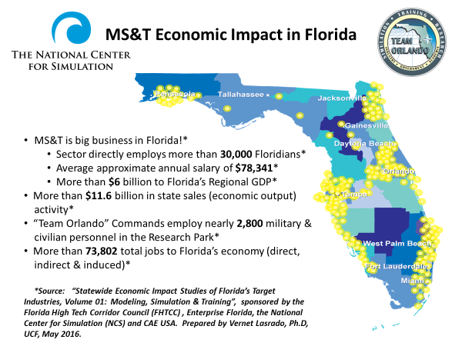

Slide 5
Winter Park

Slide 6
Objectives of This Course
To familiarize Teachers with the broad and expanding use of M&S
To familiarize Teachers with the power of M&S
To acquaint Teachers with the M&S Training Course on NCS website
To acquaint Teachers with the Industry M&S Certification
To provide Teachers with Modeling & Simulation Tools for the classroom

Slide 7
MODELING & SIMULATION TEACHER WORKSHOP
TEACHING THE TEACHER
PROGRAM AGENDA
June 6-8, 2017
June 6, 2017 Day 1 (Location-AEgis Corporation)
8:30-9:00 Continental Breakfast (AEgis-Brooke Mooney)
9:00-9:15 Welcome
Tony Krogh-AEgis Technologies
Tom Baptiste, Lt Gen,USAF (Ret)- NCS President/CEO
Dr. Cap Jadonath-Orange County Public Schools
Gene Tavares-Seminole County Public Schools
9:15-9:30 Workshop Objectives & Program Outline (NCS-Hank Okraski)
9:30-10:30 Simulations & Simulators Overview (NAWCTSD-Sandra Velez and Chad Farwig)
10:30-10:45 Break

Slide 8
10:45-11:45 Overview of Coding, Programming & Gaming (Orange Technical College-Alan Lynch & Phil Tillery)
11:45-12:30 Lunch (AEgis-Brooke Mooney)
Luncheon Speaker- PEO STRI- Dr.Jeremy Lanman
12:30-1:30 Overview of Visualization, 3D Modeling & Animation with demonstrations ( AEgis-Brian Sink, Timothy Noftsinger)
1:30-2:00 Project Management & Logistic Support (AEgis- Tony Castillo)
2:00-2:45 Ethics, Entrepreneurship & Innovation (AGT Law-Tony Tapia)
2:45-3:00 Break
3:00-4:30 Formation of Teams, Team Topic Assignments and Methodology ( Seminole County Public Schools/Hagerty HS-Lindsey Spalding)

Slide 9
June 7, 2017 Day 2 (Location-Hagerty High School)
8:30-9:00 Continental Breakfast (NCS-Carla Hoskins)
9:00-11:30 Welcome Teams and Commence Team Activities (Hagerty HS-Lindsey Spalding)
11:30-12:15 Lunch (NCS-Carla Hoskins)
12:15-4:30 Team Activities on Computers (Team Members)
June 8, 2017 Day 3 (Location-Hagerty High School )
8:30-9:00 Continental Breakfast (NCS-Carla Hoskins)
9:00-11:30 Challenges Noted and Team Activities (Team Members)
11:30-12:15 Lunch (NCS-Carla Hoskins)
12:15-1:00 Team Activities-Preparation (Team Members)
1:00-4:00 Teams Outbrief & Teachers Present Lesson Plans
4.00-4:30 Post Course Survey
4:30-5:30 OPTIONAL- Teachers take Modeling & Simulation Certification Examination on-line through Certification Partners (No Cost) (Lyn Higgins/Lindsey Spalding to coordinate with Erik Barrantes of Certification Partners)
5:30 Workshop Adjourns

