Slide 1
Simulation & Simulators Overview Sandra Velez Sr. Aerospace Engineer & Chad Farwig Aerospace Engineer Naval Air Warfare Center Training Systems Division
MODELING & SIMULATION TEACHER WORKSHOP
TEACHING THE TEACHER
Notes:
Sandra

Slide 2
NAWCTSD Mission
NAWCTSD Is the principal Navy center for research, development, test and evaluation, acquisition and product support of training systems;
We provide Interservice coordination and training systems support for the Army and Air Force, and we perform such other functions and tasks as directed by higher authority.
Notes:
Sandra

Slide 3
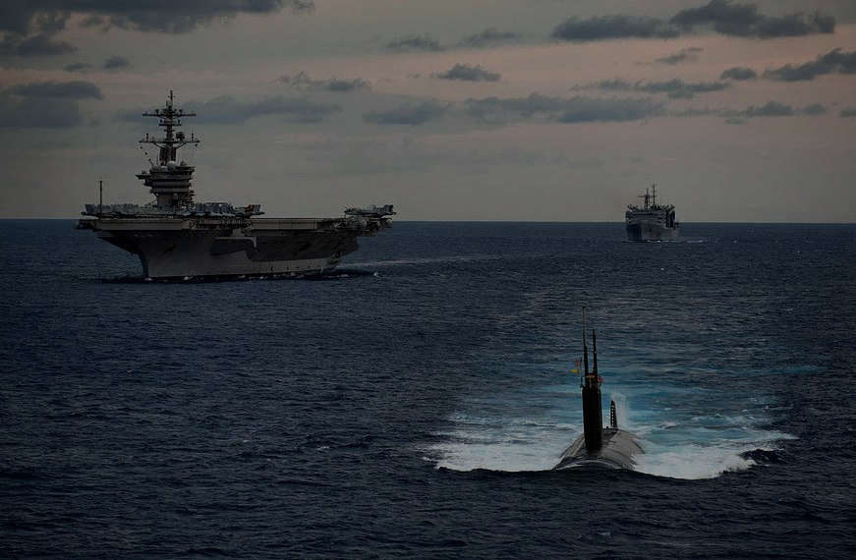
Global Support
Nation-Wide Support:
47 In-Service Engineering Offices
World-Wide Support:
Forward-deployed
Rapid team deployments to support training systems around the globe
In-Service Engineering
Notes:
Sandra

Slide 4
Air Warfare, and much more
Notes:
Sandra

Slide 5
What Is “Simulation?”
Simulation is the imitation of the operation of a real-world process or system (the “model”) over time.
Simulation first requires that a model be developed
This model represents the key characteristics or behaviors/functions of the selected physical or abstract system or process
The model represents the system itself, whereas the simulation represents the operation of the system over time.
Keys to successful simulation
Valid source information or “criteria data” – flight test data, statistical data
Simplifying approximations and assumptions
Fidelity and validity of simulation outcomes – comparison to “truth data,” repeatability
Notes:
Chad

Slide 6
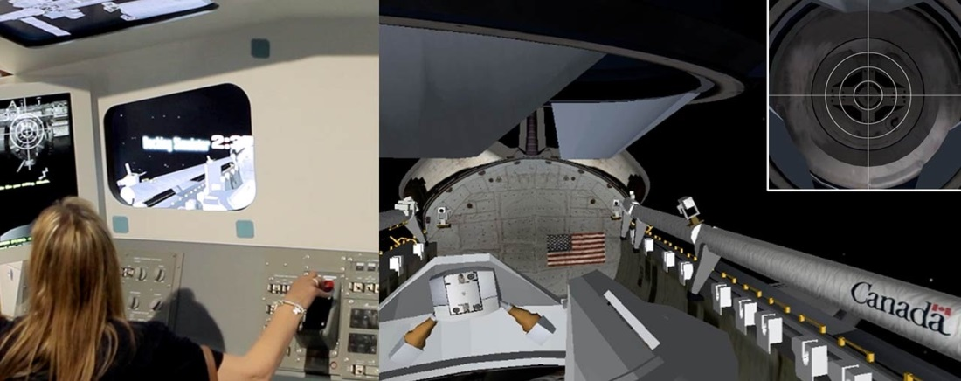
Why and When to use Simulation
Simulation is used when the real system cannot be used, because it may not be accessible, it may be dangerous or unacceptable to use, is being designed but not yet built, or it may simply not exist.
Simulation of technology
Performance optimization
Safety engineering
Testing
Training / Education
Video games
Simulation of natural systems or human systems to gain insight into their functioning.
Simulation to show the eventual real effects of alternative conditions and courses of action.
Notes:
Chad

Slide 7
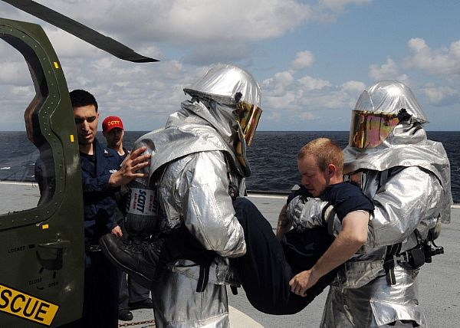
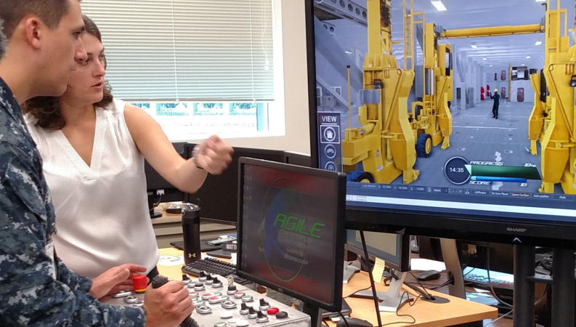
Types of Modeling & Simulation
Continuous vs. Discrete Event
Continuous – Simulation of a system over time
Scientific study, analysis
DES – Event-driven, incremental
Training, commercial uses
Live - Real people operating real systems
Virtual - Real people operating partially or completely simulated systems
Constructive – People and equipment are both simulated
Most military strategic simulations are constructive.
Relation to the “Realities”
Virtual – computer-created
Augmented - enhanced
Mixed - both real and virtual
Notes:
Chad

Slide 8
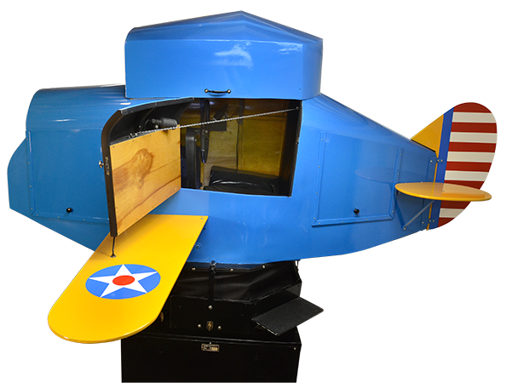
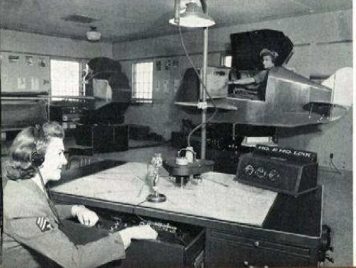
A little bit of History
First: Sanders Teacher
Complete aircraft mounted on a universal joint and facing into the wind
The Link “Blue Box”
First modern pilot trainer invented by simulator pioneer Edwin Link of Binghamton, NY in 1929
Instrument flight training
Used extensively in World War II to train US and Allied pilots
More than 500,000 US pilots trained
Computer simulation developed hand-in-hand with growth of the computer
Manhattan Project, World War II
Model nuclear detonation process
Commercial airlines recognized the effectiveness of Real-Time Simulators like the Blue Box and began to use them for aircrew training
Notes:
Sandra

Slide 9
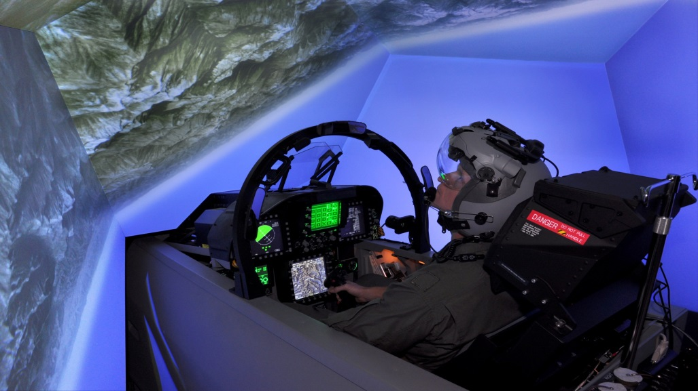
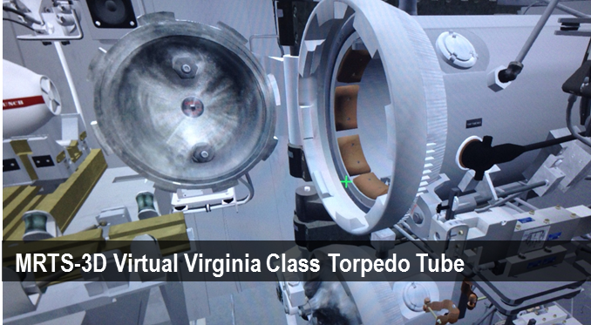
Real-Time Virtual Simulators
Simulators - substitute for real world systems
Most common and save time, money, and lives
Military and commercial training (flight, emergency procedures)
Science and tech (space program, industrial apps)
Entertainment (theme park rides, motion capture for movie industry)
Health (training devices, DaVinci robotic surgery)
Level of Fidelity (realism)
Functional vs. Physical
Transfer of Training / Training Effectiveness
Certification
“Garbage In / Garbage Out”
Australia F/A-18
Notes:
Sandra

Slide 10
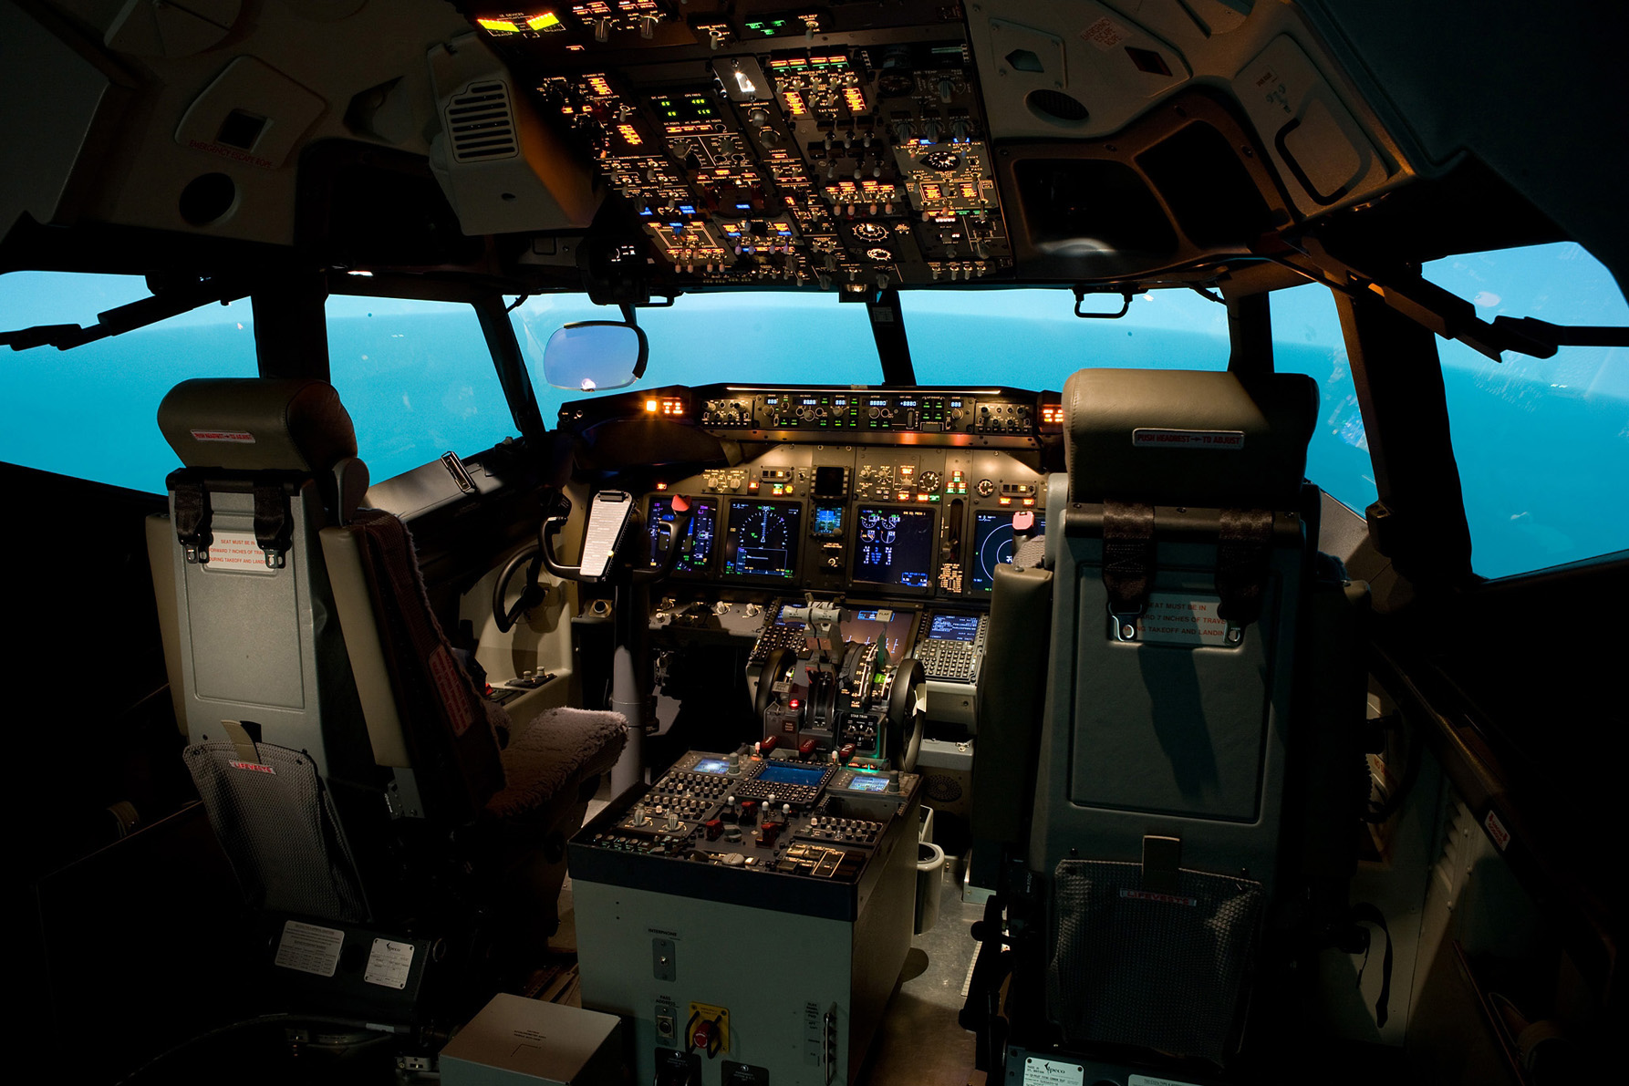
Fidelity in Simulators
P-8A Poseidon
Operational Flight Trainer Cockpit
Notes:
Sandra

Slide 11
Virtual Simulator Components
Simulator Building Blocks
System Block Diagram
Trainee Station
Cockpit area in a flight simulator
Computational System
Computer or family of computers
Visual System
Image generator, displays and data bases
Instructor/Operator Station
Controls scenarios, inserts malfunctions, etc.
Aural System
Communications, engine noises, alarms, environmental noises, etc.
Motion System
Platform, g-seat/g-suit, motion seat, seat shaker
Control Loader
Stick & rudder forces in flight simulator
Interface Hardware and Software
Enables computers and other hardware/software to communicate
Notes:
Sandra

Slide 12
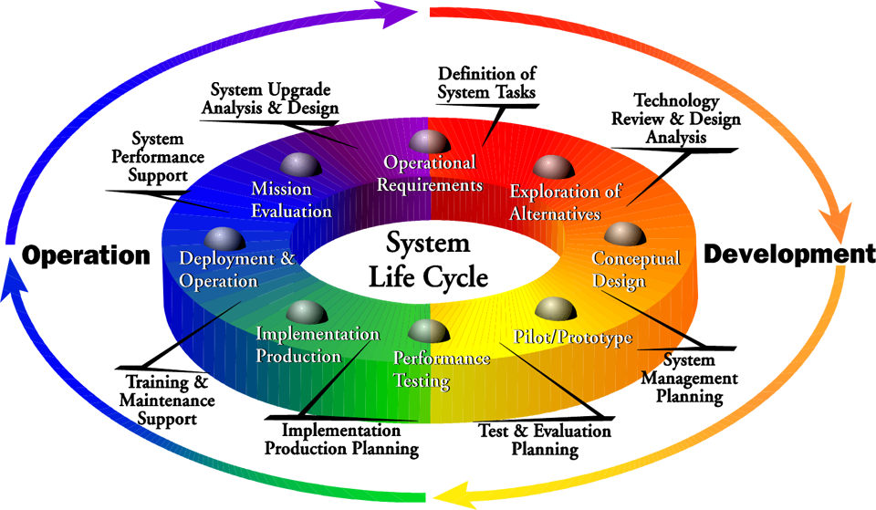
Systems Engineering
Systems Engineering (SE) is an interdisciplinary field of engineering and engineering management that focuses on how to design and manage complex systems over their life cycles.
Systems engineering ensures that all likely aspects of a project or system are considered, and integrated into a whole.
Notes:
Chad

Slide 13
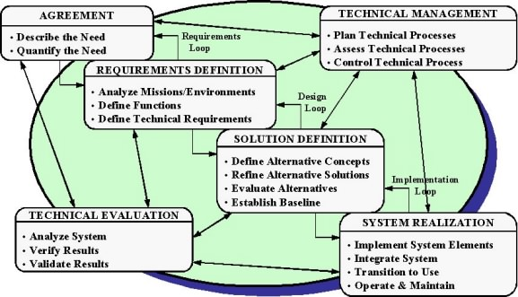
Systems Engineering Process
Systems engineering process provides technical insight into the holistic status of the program.
Systems Engineering Considerations
Fully understand the requirements
Many technical disciplines interact in an IPT
Trade-offs, limitations
Cost drivers
Schedule drivers
Resources to operate and maintain system
System architecture limitations on upgrades/refresh
Continuous evaluation throughout
Notes:
Chad

Slide 14
SE Technical Reviews
End-to-end perspective and integration of SE technical reviews and audits across the acquisition life cycle
Computer/computing knowledge is critical to being able to design and implement programs that will ultimately become simulations.
Most real-time simulators integrate hardware and software to achieve a total system or sub-system.
Notes:
Chad

Slide 15
SE Design and Review Process
SE “V” Diagram
“V”alidation & “V”erification
Specification ← → Testing
Notes:
Chad

Slide 16
SE Fundamentals
Know the requirements (what’s needed?!)
These requirements are then further derived to better determine the technical design approach (Trace these in a Requirements Traceability Matrix (RTM))
The RTM allows changes in design to flow back to the base requirements (training objective and training requirements for training systems)
The RTM also flows to design documentation throughout the program, resulting in the basis for your test procedure.
Capture Program Risks and document with impact and mitigation strategies.
Document and Brief this to a Risk Team on a planned schedule. (no surprises!)
Technical design reviews – these are held based on the progression of the design development to ensure to design is mature enough to go onto the next development stage.
Continually evaluate the teams’ status, personnel requirements, schedule considerations, interim product item completion.
The amount of documentation and the extent of the review are based on the complexity and risk of the program.
Notes:
Chad

Slide 17
Integrated Logistics Support - ILS
The elements of design and support necessary to provide for the effective support of the system for its programmed life cycle
Maximize simulator availability
Minimize Life Cycle Costs (LCC)
Integrated Logistics Support Elements
Design Interface (RAM)
Maintenance Planning
Supply Support
Support & Test Equipment
Manpower & Personnel
Training & Training Support
Technical Data & Publications
Computer Resources Support
Facilities
Packaging, Handling & Transportation
Notes:
Sandra

Slide 18
ILS – Training Effectiveness Ratio
Training Effectiveness Ratio (TER)
An indicator of how substituting time in a simulator transfers to student performance in the operational system (aircraft).
Measured by comparing training time in the operational system (aircraft) with the combination of simulator plus aircraft times.
Example:
A pilot achieves a certain level of proficiency after 100 hours in the aircraft.
The pilot achieves the same level of proficiency after 80 hours in the aircraft AND 40 hours in the simulator.
$TER=\frac{100 −80}{40}$ = 0.5 TER
Relation between TER and cost effectiveness
Time in a simulator is approximately 10%-15% of the cost of operating an aircraft.
Safe and is much more training effective.
Training scenarios can be practiced repeatedly without setting up similar situations using aircraft or other costly assets.
Instant feedback as opposed to waiting for a complete training exercise to be completed.
Where
Yo = Time in only the operational system (aircraft) to achieve a level of criterion performance
Yx = Time in the operational system (when coupled with the simulator)
X = Time in the simulator (when coupled with operational system)
Notes:
Sandra

Slide 19
ILS – RAM & LCC
RAM - The “abilities”
Reliability
MTBF – how long before it fails (in hours)
Failure Rate (Lambda)
= $1/{MTBF}$
Availability – ready to use
A = $\frac{MTBF}{(MTBF+MTTR)}$
Maintainability
MTTR – how long will it take to fix
Impact to total Life Cycle Costs
Another look at the System Block Diagram…
Visual Display System:
MTBF= 80,000 hrs, FR=.0000125
MTTR=15Min
Visual Image Generator:
MTBF= 4,000hrs
MTTR=20min
Notes:
Sandra

Slide 20
Training for Readiness
What kind of trainer is it?
Live
Virtual
Constructive
Live & Virtual
Notes:
Sandra

Slide 21
Questions?
Notes:
Sandra

Slide 22
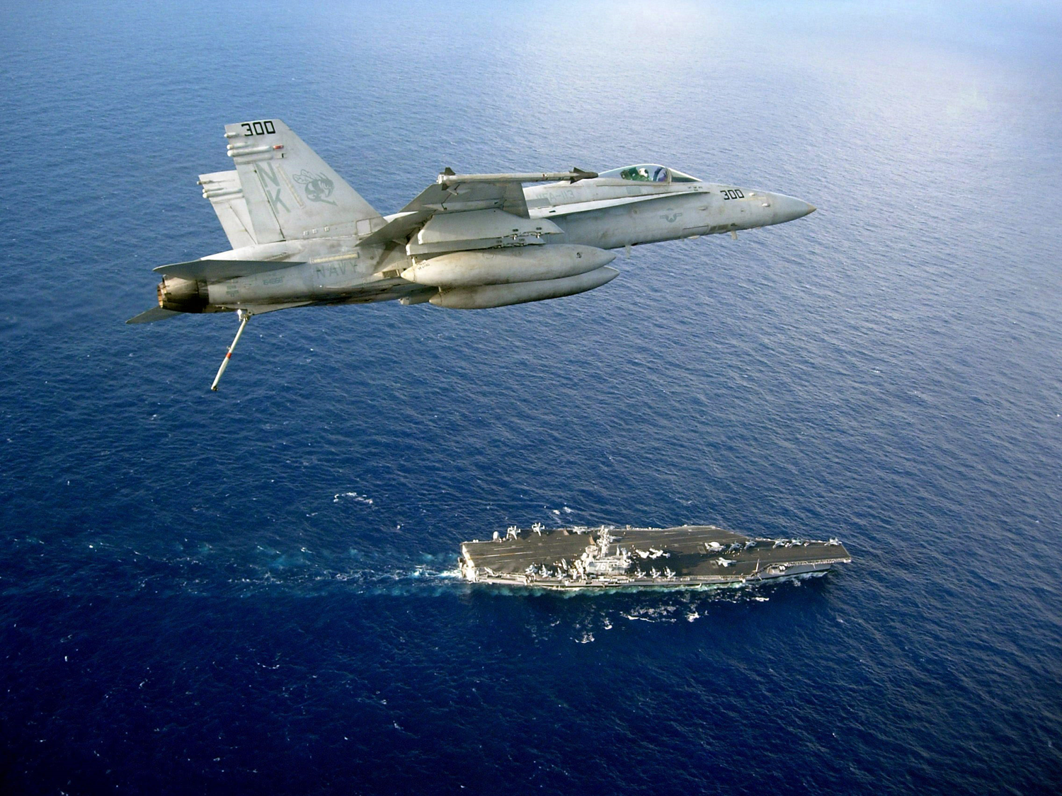
Notes:
Sandra

