Slide 1
Software Development for Teachers
Crooms
Academy Of Information Technology
Software Development Basics
Modeling & Simulation & STEAM
Starting Your M&S Program
Seminole County Public Schools

Slide 2
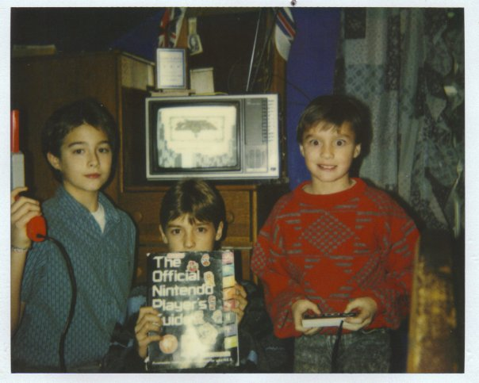
About ME
Musician / Entertainer
UCF Grad in Digital Music
Worked at Disney as a Trumpet Player
Teacher (10 Years at Crooms)
Music Performance, Theory & Composition
3D Modeling & Animation
Video Production
Project Management
Game & Simulation Foundations & Design
Curriculum Writer
Worked on the M&S curriculum
Created multiple experimental classes
Gamer
Game Designer

Slide 3
My Presentation Goal
Simplify and remove the fear from the M&S curriculum.
Software development process basics.
How game & sim software development relates to and supports STEM curriculum.
How and why you will want to integrate a M&S program into your school’s curriculum.
Clayton Donnan cndonnan@gmail.com Crooms Academy of Information Technology

Slide 4
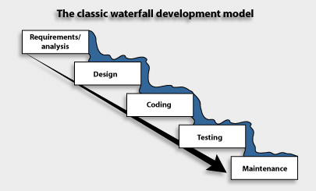
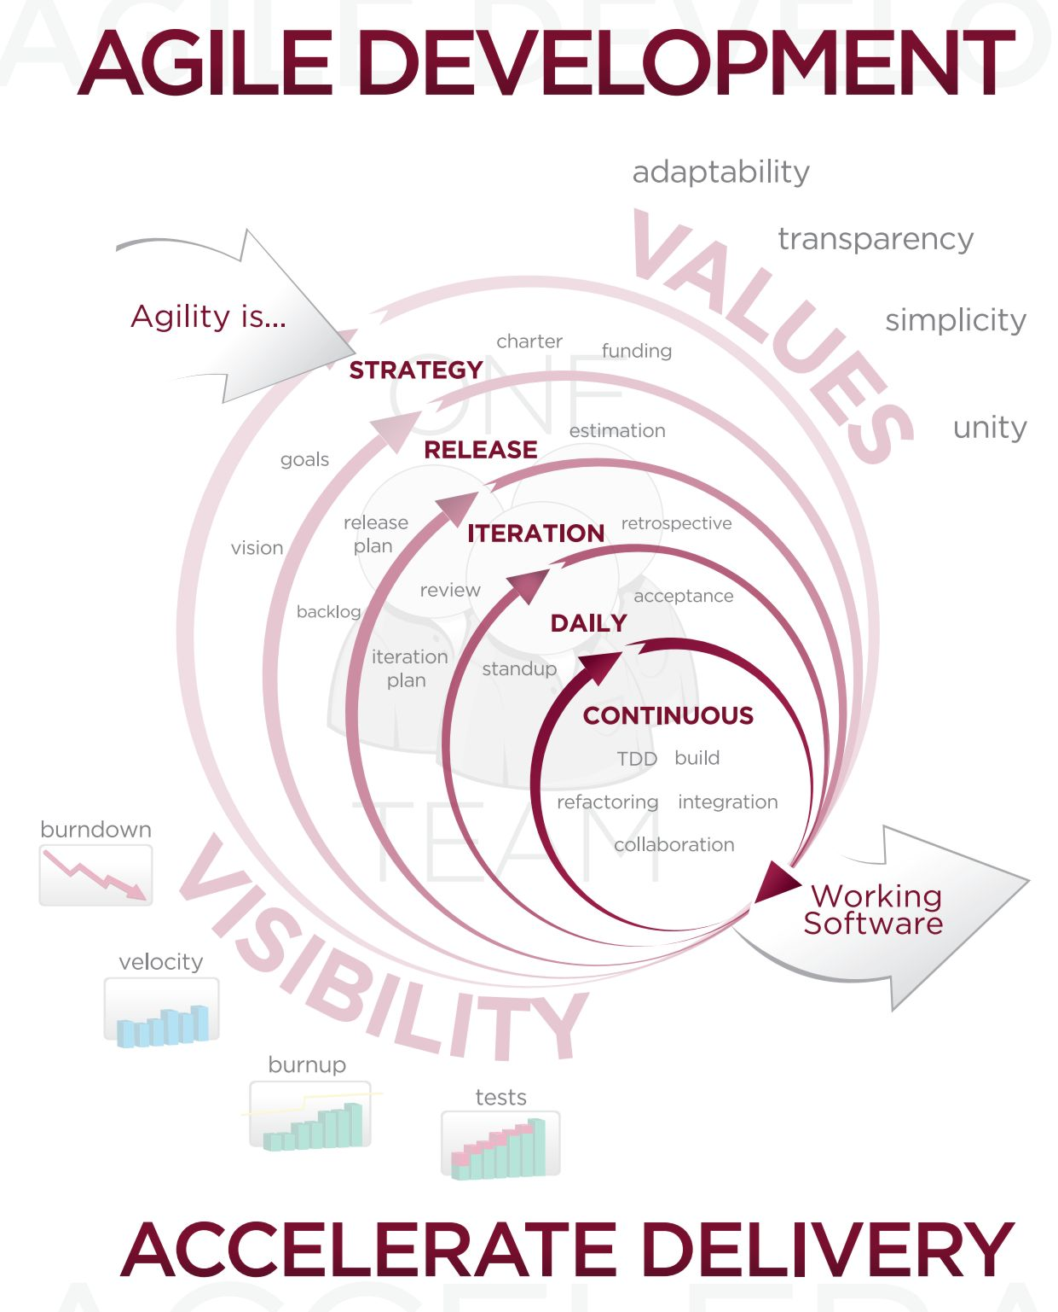
The Basics of Software Dev
Waterfall vs. Agile
Waterfall
Plan driven
Good for well defined problems that undergo very little change during development.
Agile
Value / vision driven
Good for programs that can drastically change over the course of development.
Clayton Donnan cndonnan@gmail.com Crooms Academy of Information Technology

Slide 5
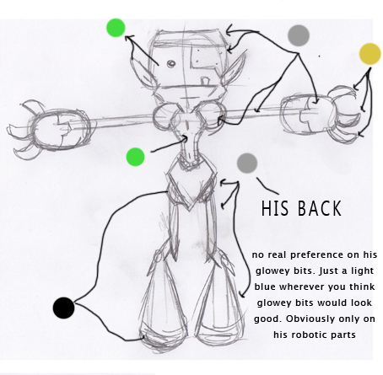
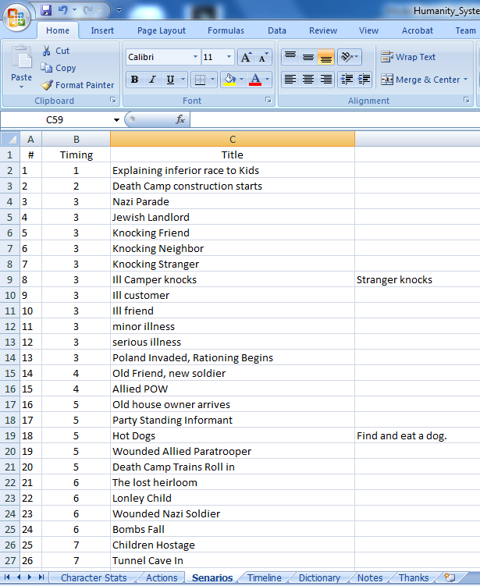
Agile software Development
Step One – Planning
Determine Scope
Determine Objectives
Identify & Resolve Risks
The Iron triangle
Create a Detailed Design Doc
Must meet goals
Must mitigate as many known risks as possible
Clayton Donnan cndonnan@gmail.com Crooms Academy of Information Technology

Slide 6
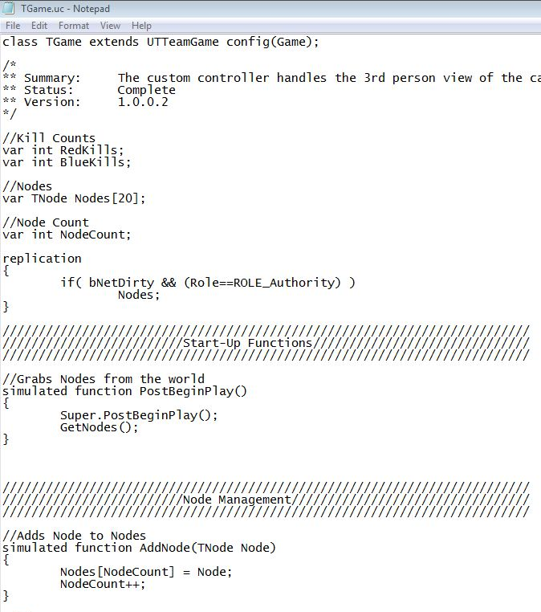
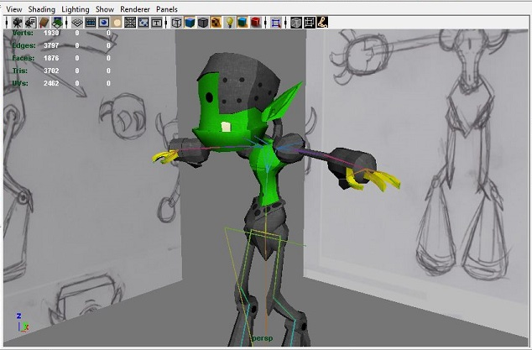
Agile software Development
Step Two – Development
Use detailed design doc to create code
Integrate code into the rest of the project
Verify and validate (test) any newly created code.
Clayton Donnan cndonnan@gmail.com Crooms Academy of Information Technology

Slide 7
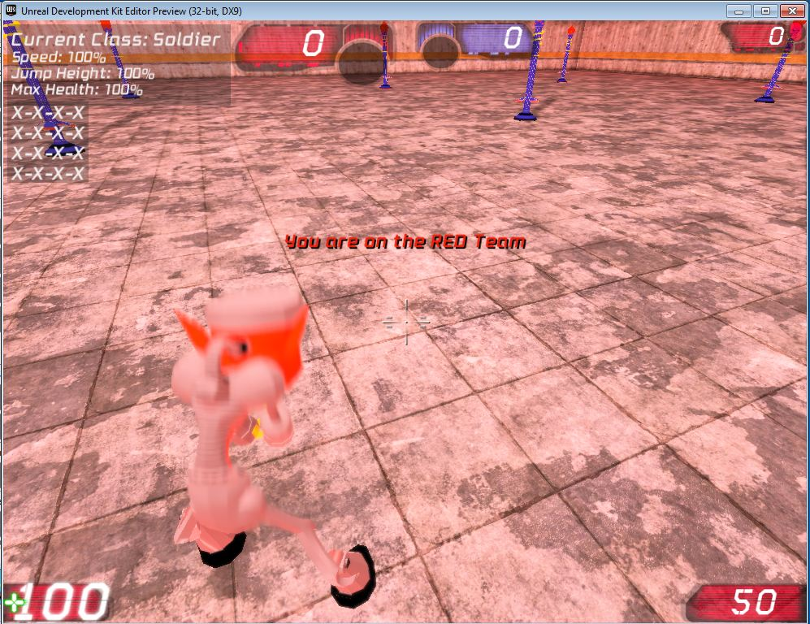
Agile software Development
Step Three – Release
Release the completed portion to the review team
OR
Release the software to market
(which is also a review team)
Clayton Donnan cndonnan@gmail.com Crooms Academy of Information Technology

Slide 8
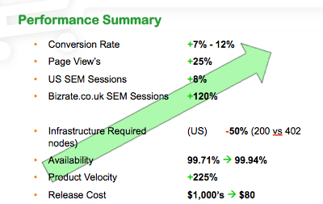
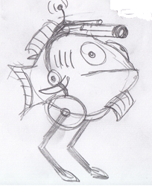
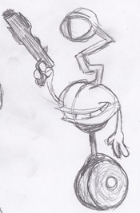
Agile software Development
Step Four – Review & plan the next generation
Review how well the product performed
Determine what flaws are the most detrimental or frustrating to the user
Clayton Donnan cndonnan@gmail.com Crooms Academy of Information Technology

Slide 9
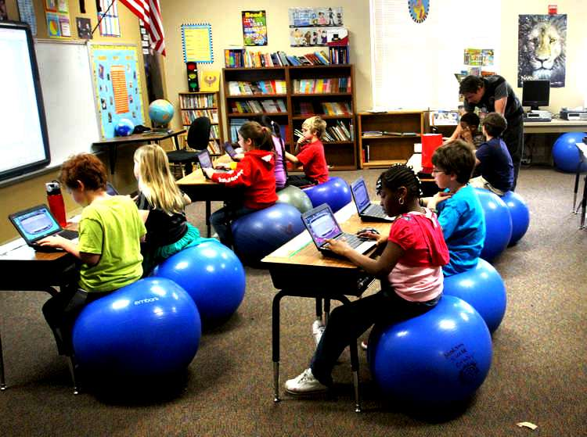
How M&S Relates to Students
Clayton Donnan cndonnan@gmail.com Crooms Academy of Information Technology

Slide 10
How M&S relates to Students
Today
Students are already playing game based simulations
A majority of the art the students view is digital.
When students build simulations they learn about the multitude of variables inherent within a system
Clayton Donnan cndonnan@gmail.com Crooms Academy of Information Technology

Slide 11
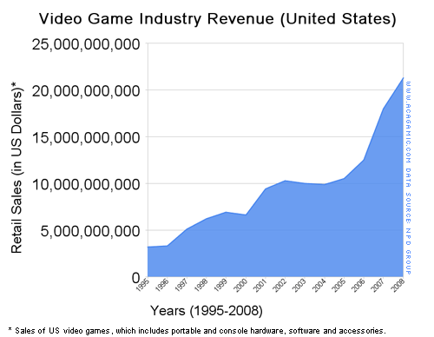
How M&S relates to Students
Tomorrow
Informed Digital Natives
Jobs
Clayton Donnan cndonnan@gmail.com Crooms Academy of Information Technology

Slide 12
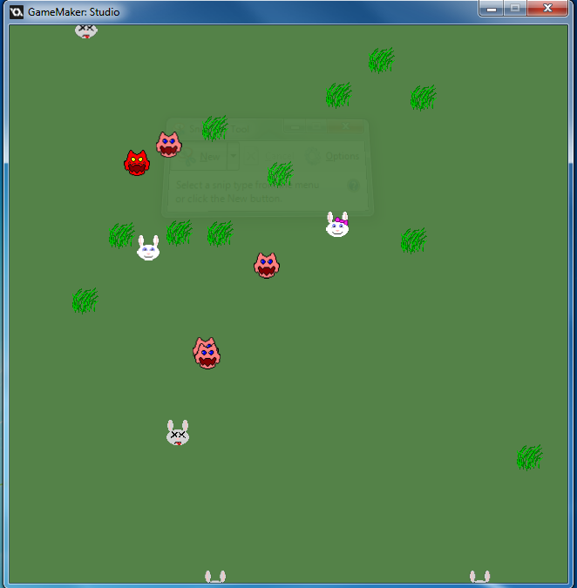
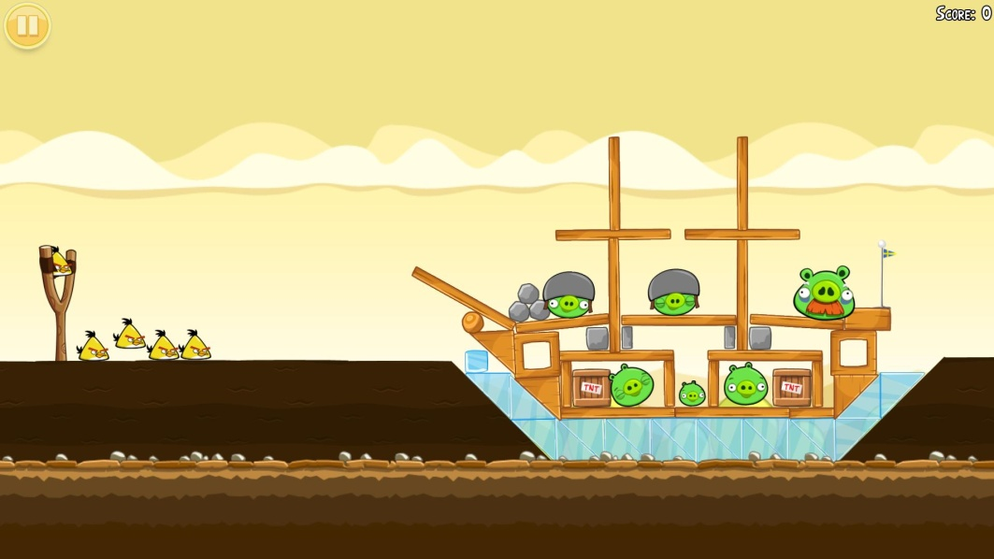
How M&S Relates to Science
Science
Physics
Chemistry
Biology
Clayton Donnan cndonnan@gmail.com Crooms Academy of Information Technology

Slide 13
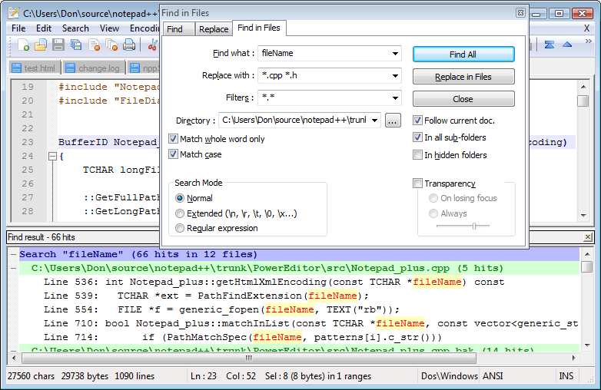
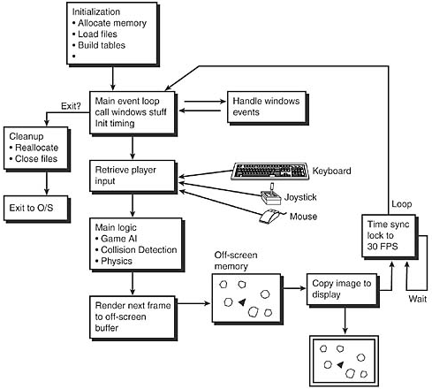
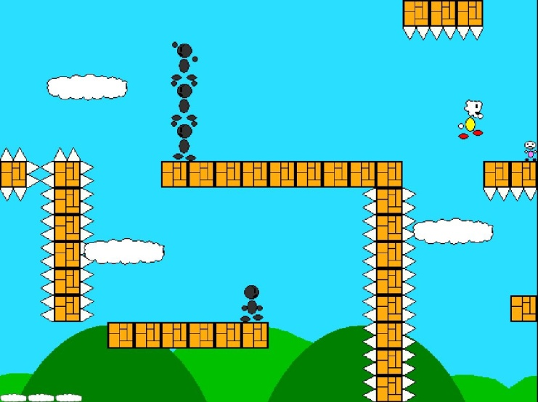
How M&S Relates to Technology
Technology
Programming
Digital Art
Modern communication skills
Clayton Donnan cndonnan@gmail.com Crooms Academy of Information Technology

Slide 14
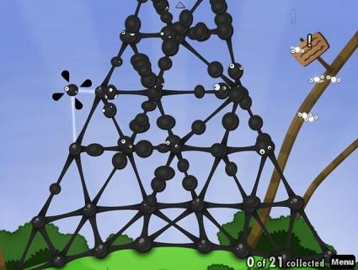
How M&S Relates to Engineering
Engineering
Logical thinking
Problem solving
Solution design
Variable determination
Solution testing & analysis
Clayton Donnan cndonnan@gmail.com Crooms Academy of Information Technology

Slide 15
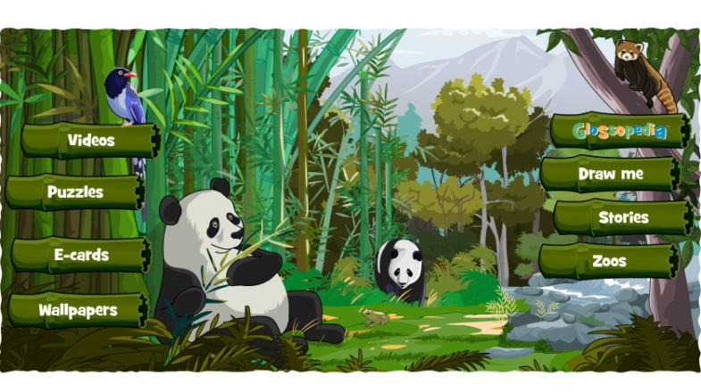
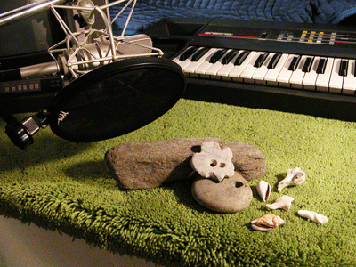
How M&S Relates to Art
Art
Digital Art
CAD
Scale & Proportion
Music
Theory & Composition
Audio Production
Clayton Donnan cndonnan@gmail.com Crooms Academy of Information Technology

Slide 16
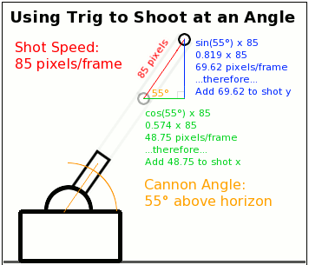
How M&S Relates to Math
Mathematics
Conversions
Probability
Logic
Algebra
Geometry
Trig
Physics
Clayton Donnan cndonnan@gmail.com Crooms Academy of Information Technology

Slide 17
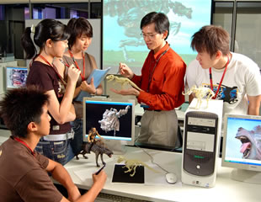
How to start a M&S Curriculum
Clayton Donnan cndonnan@gmail.com Crooms Academy of Information Technology

Slide 18
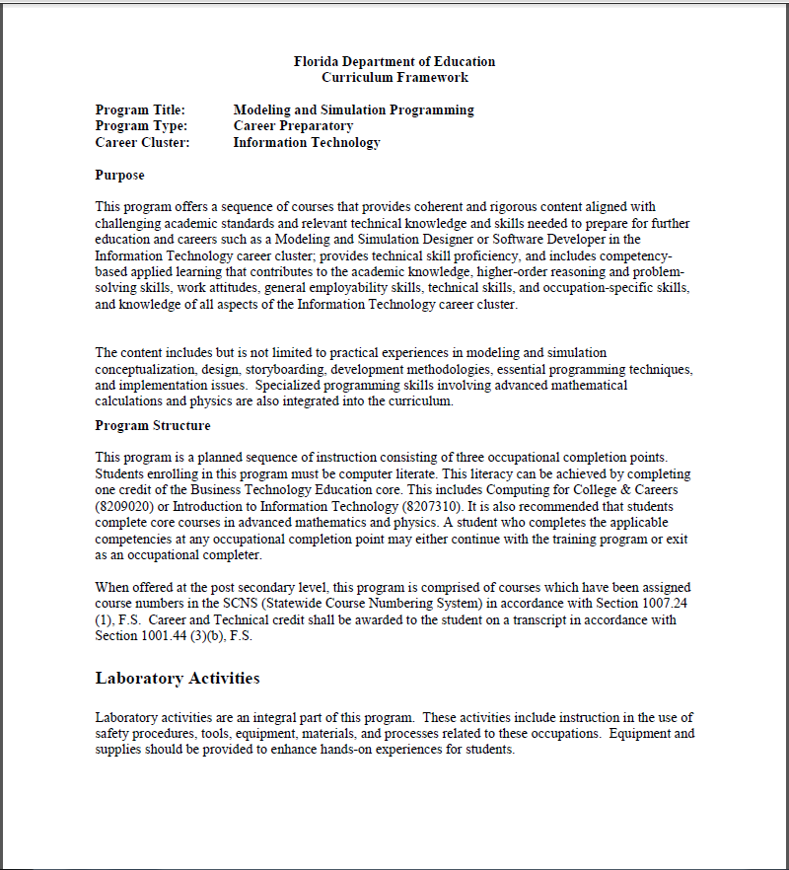
Where Do I sTart?
Fl DOE Framework
Year 1 - M&S Foundations
Year 2 – M&S Sim Design
Year 3 –
Software Development
Visual Development
Year 4 – M&S Research
Model Curriculum
M&S Concepts
Computer Skills
Investigating M&S
Visualization
Problem Analysis
Math Skills
Software Design & Dev
Real-Time Virtual Sims
Commercialization
Project Management
Logistics Engineering
Ethics
Clayton Donnan cndonnan@gmail.com Crooms Academy of Information Technology

Slide 19
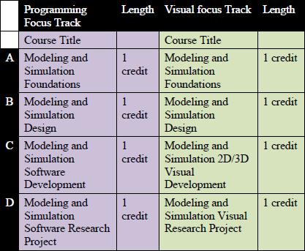
How Does it Work
Clayton Donnan cndonnan@gmail.com Crooms Academy of Information Technology

Slide 20
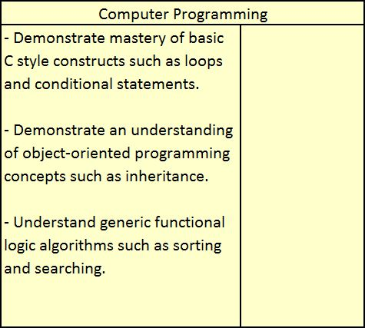
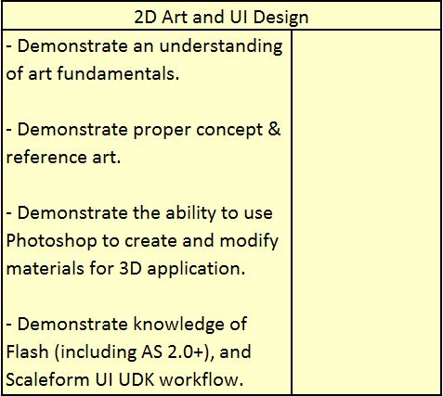
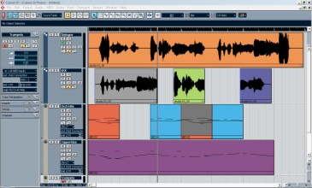
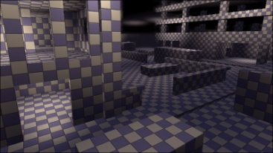
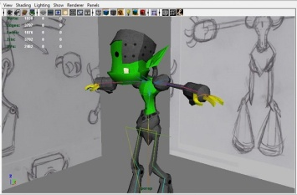
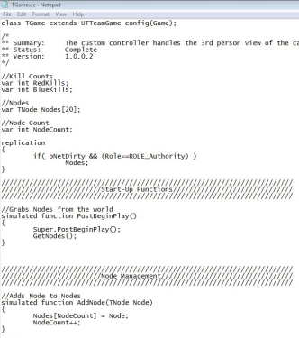
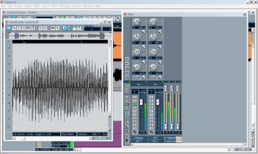
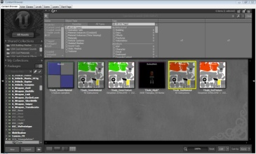
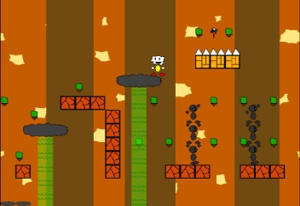
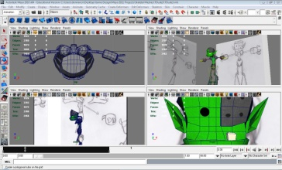
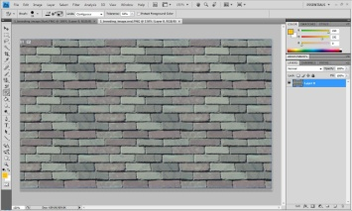
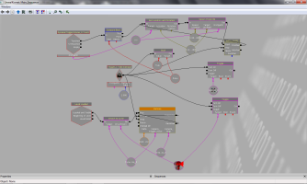
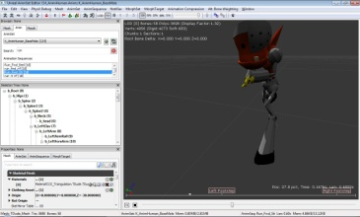
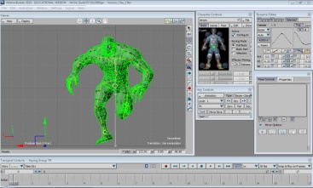
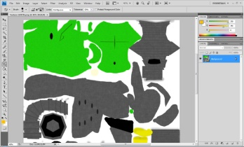
The Crooms Academy Example
Clayton Donnan cndonnan@gmail.com Crooms Academy of Information Technology

Slide 21
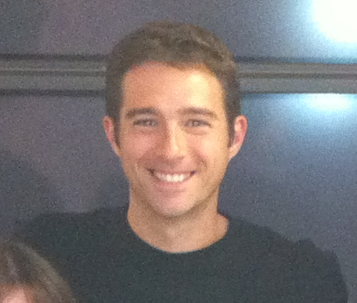
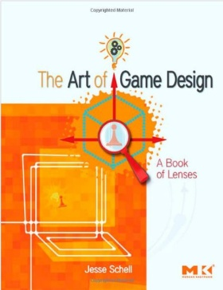
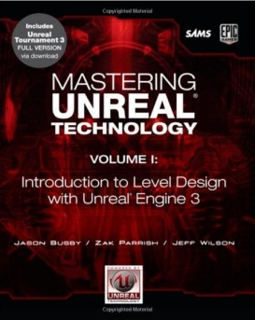
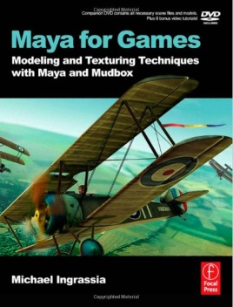
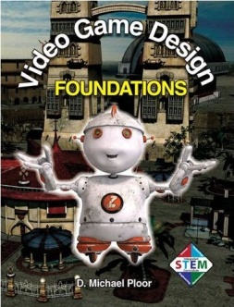
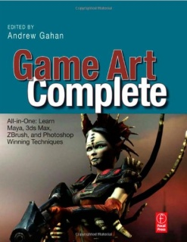
Program needs
Staff
At least one teacher
that is passionate
Self education time
Support
Administration
Business
Materials
Standard School Supplies
Calculator
Random Number Generators
Clayton Donnan cndonnan@gmail.com Crooms Academy of Information Technology

Slide 22
Program Wants - Staff
More than one teacher will be needed for true specialization
Special, specific, professional training in areas that you are weak
Clayton Donnan cndonnan@gmail.com Crooms Academy of Information Technology

Slide 23
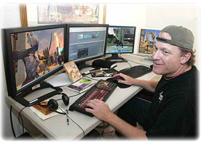
Program Wants - Hardware
Computers – the faster the better
Multiple Monitors help with the visualization process
Clayton Donnan cndonnan@gmail.com Crooms Academy of Information Technology

Slide 24
Program Wants - Software
Free
2D Game Engines
GameMaker Studio
GameStudio
Torque2D
Art Programs
2D - GIMP
3D – Blender
3D Game Engines
UDK
Unity
Torque3D
GameStudio3D
Code Editors
Notepad ++
Clayton Donnan cndonnan@gmail.com Crooms Academy of Information Technology

Slide 25
Program Wants - Software
Paid
2D Game Engines
Art Programs
2D Art
Photoshop
3D Art
3D Studio Max
Maya
Motion Builder
Mudbox
Zbrush
SoftImage
3D Game Engines
Clayton Donnan cndonnan@gmail.com Crooms Academy of Information Technology

Slide 26
YOU CAN DO IT!
Clayton Donnan cndonnan@gmail.com Crooms Academy of Information Technology

