Slide 1
Orange County Public Schools
Orange Technical College
October 11, 2017

Slide 2
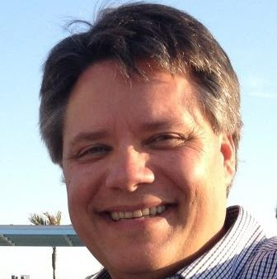
Winter Park Campus
Winter Park High School
Modeling Simulation Production
Postsecondary program
Year one
New instructor – Kent Wenger
Working on equipment upgrades

Slide 3
Winter Park Campus
University High School
Modeling Simulation (Design/Production)
Postsecondary Program
Year of Planning
Program determination
Instructor
Equipment needs
Connection to existing academies

Slide 4
Orange County Public Schools
Modeling and Simulation Certification (NCS)
Timber Creek High School
Game/Simulation/Animation – Jon Frankos
14 students passed
University High School
Game/Simulation/Animation (postsecondary)
9 students passed

Slide 5
Mid Florida Campus
The Launch Site
Serious Game Jam 2
Launchland Theme Park Jam
I/ITSEC
Mars Escape Room
HoloLens
Kenworth Rear End Differential training
STEM EXPO - February

