Slide 1
Building a Sustainable 4 year Modeling and Simulation High School Program
Presented by
Lindsey Spalding
Hagerty High School
Seminole County Public Schools
407-871-0776
Lindsey_spalding@scps.k12.fl.us

Slide 2
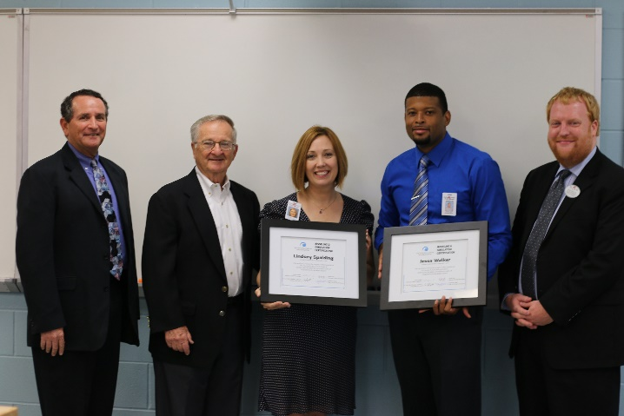
Introduction
"I do the things I can not do, in order to learn how to do them." — Pablo Picasso
Lindsey Spalding
I teach students to work individually and collaboratively building 3D models, virtual simulations and engineered prototypes, while practicing ethical and societal awareness necessary to function in a highly technological global society.
Global Learning and Curiosity
Global Citizenship and the value of life long learning
14 years using 3D models, Phet simulations and virtual labs for teaching and learning science
2yrs + Building a 4 year Modeling and Simulation Program of Emphasis
Earned Modeling and Simulation Certification
*Env. Eng. Technologies
*Environmental Science
*Teacher Leadership for Science Education

Slide 3
Building a Sustainable Modeling and Simulation High School Program
The Big Picture
A Workforce in Need
Establish workforce/education teams to address workforce/education needs
Work as collaborative teams to establish program parameters and goals for a high school CTE program
Work as collaborative teams to develop frameworks, curriculum and certification exam for high school CTE program to be approved by DOE
Build a sustainable 4 year high school program that produces students with global outlook, technical skills and high interest in pursing careers in M & S fields to sustain a M & S workforce
Establish a pilot program to help Improve frameworks, curriculum and certification exam based on best practices in classroom
Work as collaborative teams to test frameworks, curriculum, and exam with-in high school classrooms
Work in Progress
Notes:
NCS – Developed the Education and Workforce Development Committee
NCS – Published https://www.simulationinformation.com/

Slide 4
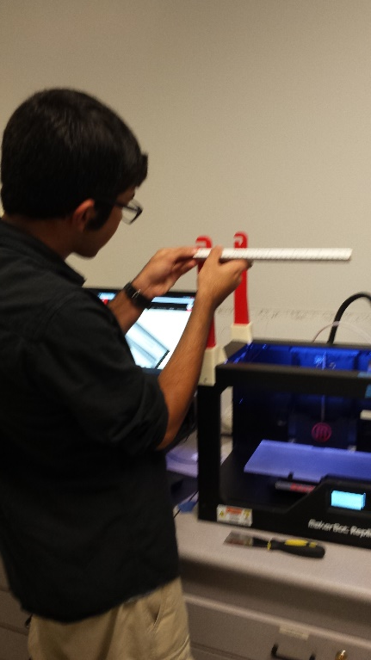
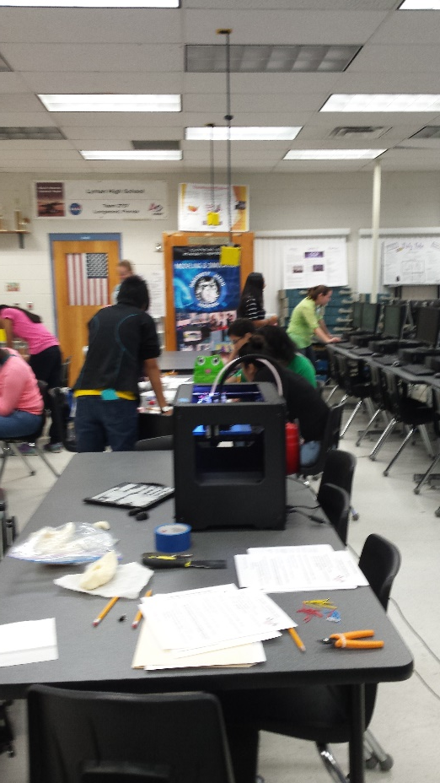
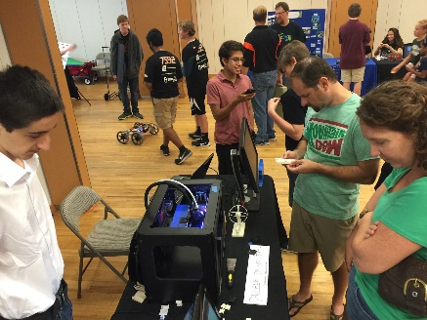
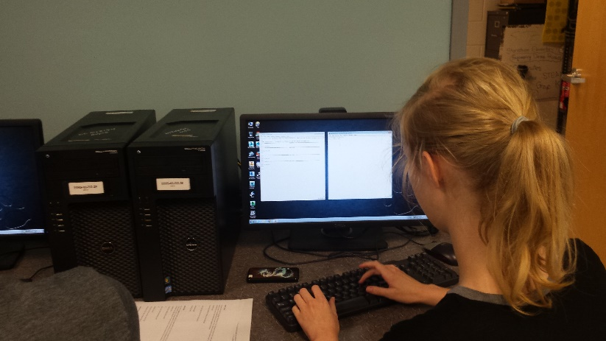
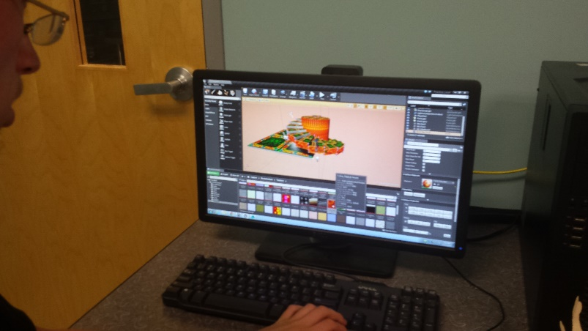
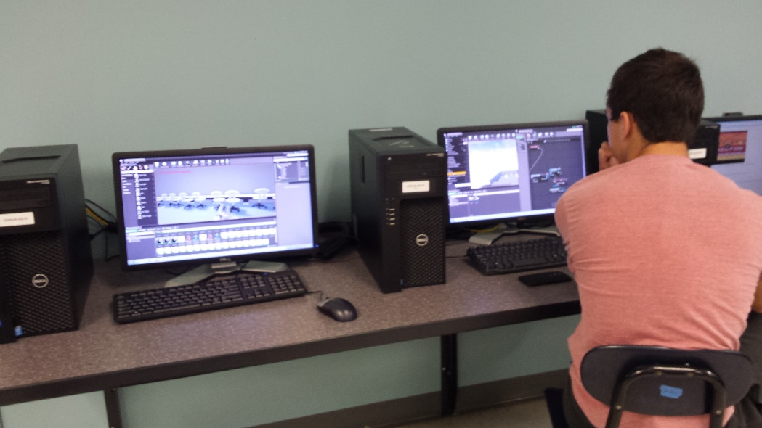
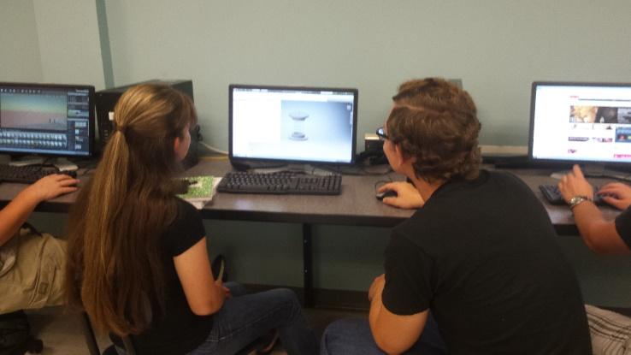
Building a Program Model to Communicate the Big Picture.
What a High School Modeling and Simulation Program Offers Students
Establish a pilot program to help Improve frameworks, curriculum and certification exam based on best practices in classroom
Hagerty High School (HHS) Students are developing career and technical abilities focusing on communicating and problem solving with modeling and simulation technologies.
Students work individually and collaboratively building 3D models, virtual simulations and engineered prototypes while practicing ethical and societal awareness necessary to function in a highly technological society.
In coordination with the National Center for Simulation (NCS) and Seminole County Public Schools (SCPS), HHS offers a four year certification program giving students an opportunity to gain practical experiences in modeling and simulation conceptualization, design, development methodologies, essential programming techniques, prototype development, production processes and implementation challenges resulting in an industry accredited certification.
This program allows students to vison themselves somewhere along the pathway to a career in Modeling and Simulation and then take action through participation in many competitive and noncompetitive projects to reach their goal.
Students enhance their personal knowledge and skills by participating in and organizing community events highlighting emerging technologies and skills being practice that lead to careers in many highly technical industries including modeling and simulation.
The program is unique in its ability to motivate a large learning population due to its fluid and diverse nature. It is a great example of an interdisciplinary STEAM program that offers all students from the digital artists to the computer engineers an interesting and meaningful life learning experience.
Notes:
The Program Goal. How are we putting the pieces together?

Slide 5
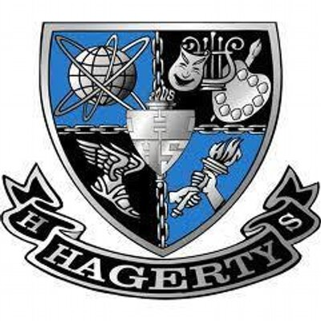
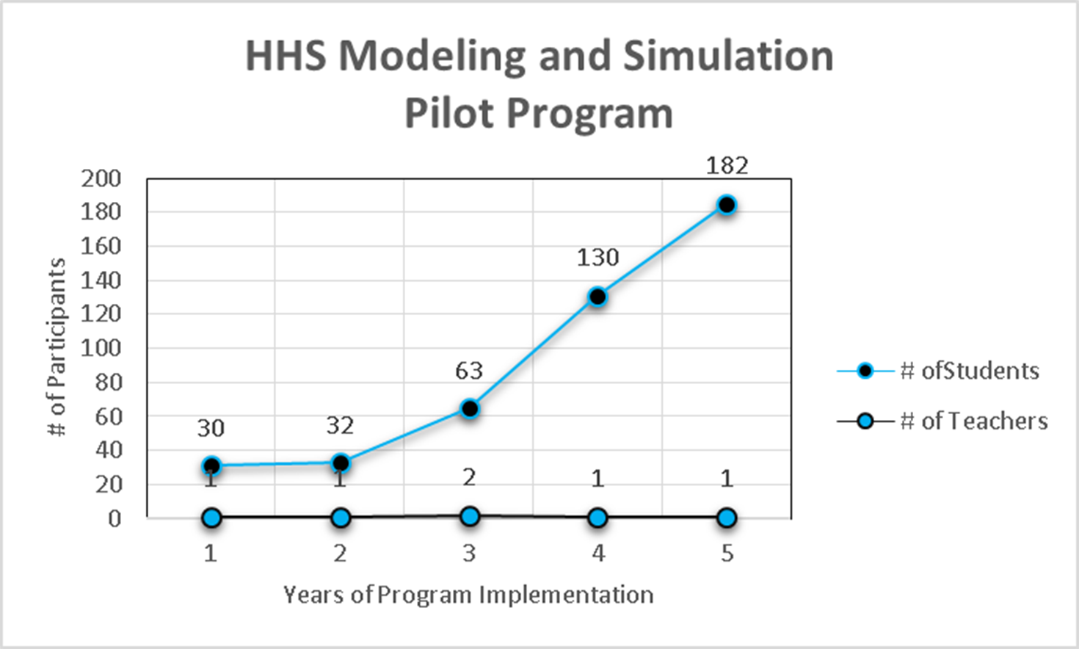
Hagerty High School Seminole County Public Schools
How we are putting the pieces together to form the Big Picture
Establish a pilot program to help Improve frameworks, curriculum and certification exam based on best practices in classroom
Milestones
2013-2014
Frameworks reorganized by SCPS and sent to DOE for approval
First M & S Learning Lab established
3rd teacher attempt
Student numbers doubled
2014-2015
Frameworks approved by DOE!
2nd M&S Learning Lab built
Beta Exam for Certification
76% student pass rate
2015-2016
Certification exam approved by DOE
1 teacher /182 students
Challenged by a lack of teachers
Notes:
Lindsey Spalding joined the team at the very end of year 3 (2013-2014). I worked with Stephanie Wall (SCPS CTE) to reorganize frameworks and submit to the state.
1st 2 years team worked to establish a framework and curriculum posted to the NCS web-site.

Slide 6
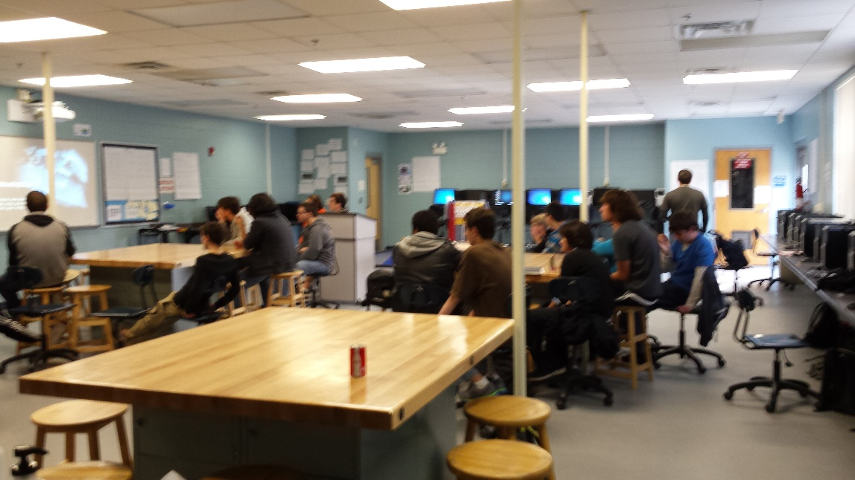
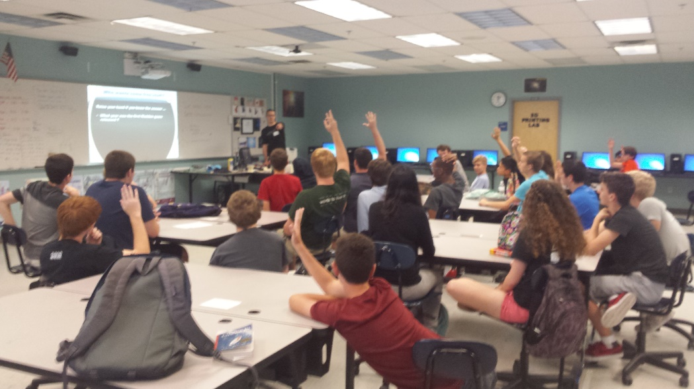
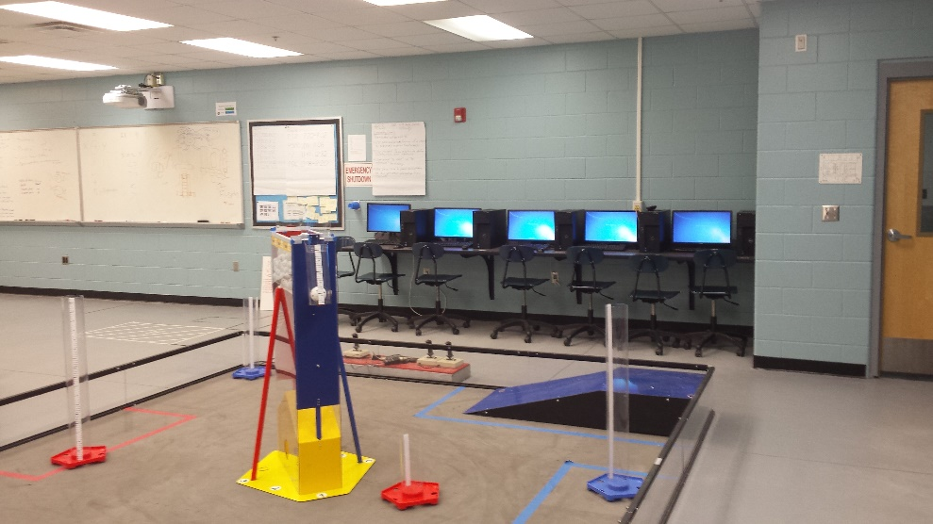
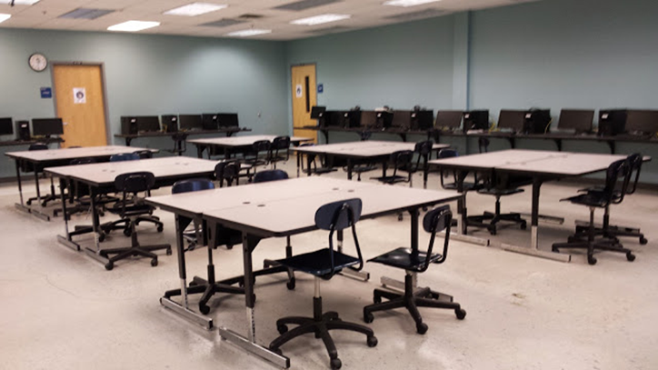
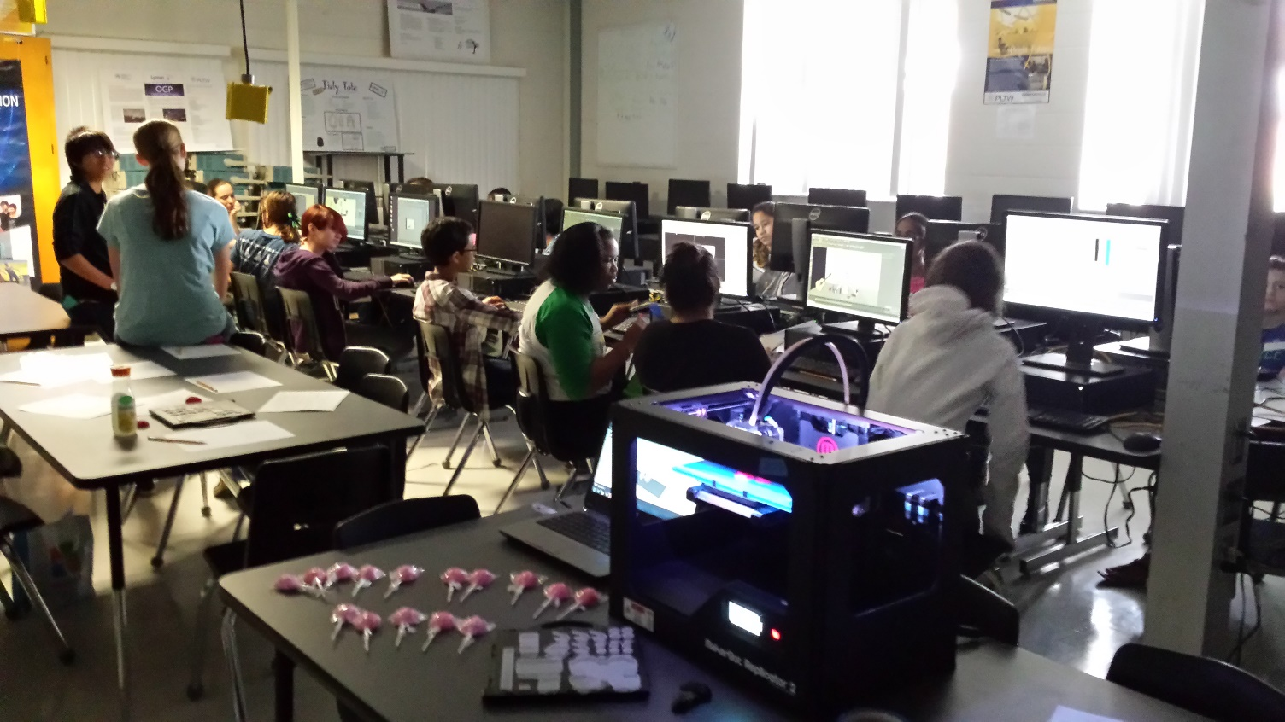
Hagerty High School Seminole County Public Schools
Establish a pilot program to help Improve frameworks, curriculum and certification exam based on best practices in classroom
Milestones
2013-2014 – 63 students
First M & S Learning Lab established
3rd teacher attempt
Student numbers doubled
Frameworks reorganized by SCPS and sent to FLDOE for approval
We learned the importance of Infrastructure!
“Replace traditional Computer Labs with Learning Labs “
Individual learning space
Collaborative learning space
Build/Testing space
Program Supportive Hardware
Program Supportive Software
Notes:
Lindsey Spalding joined the team at the very end of year 3 (2013-2014). I worked with Stephanie Wall (SCPS CTE) to reorganize frameworks and submit to the state.

Slide 7
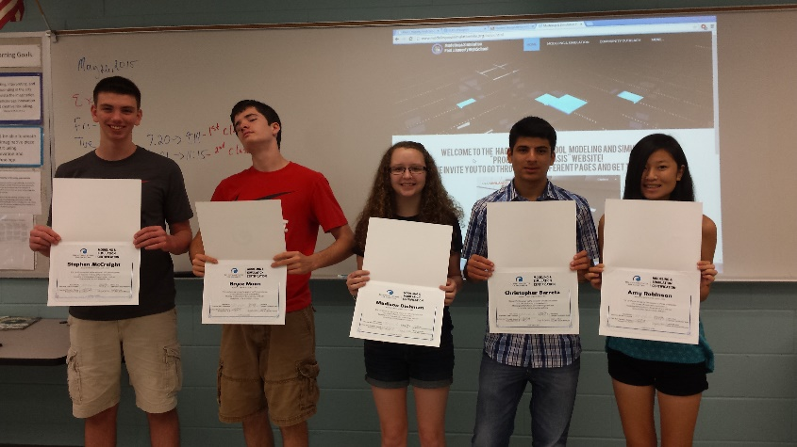
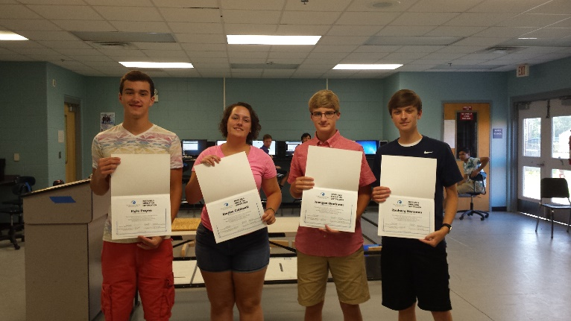
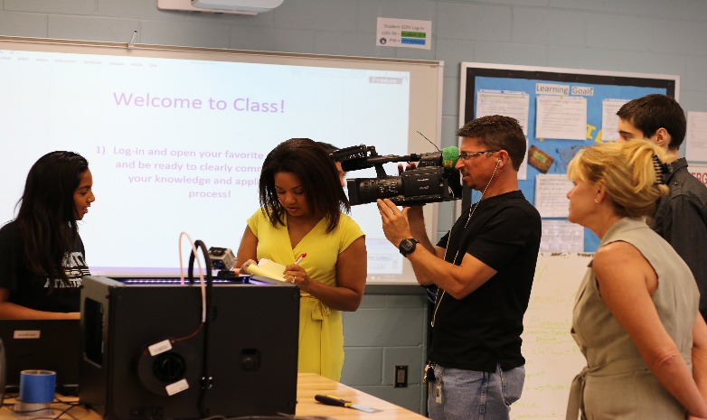
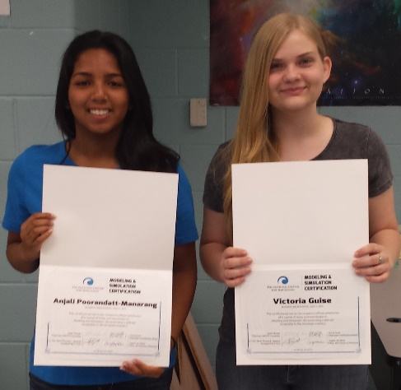
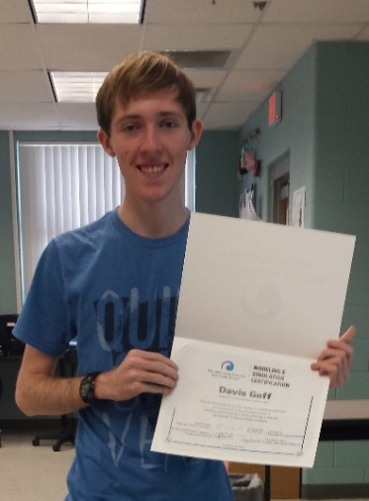
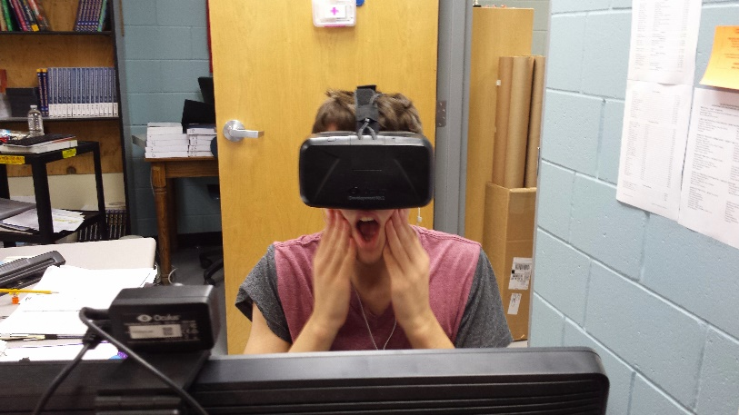
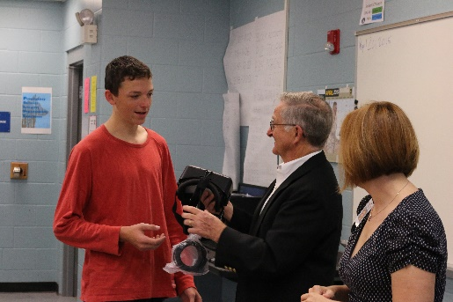
Hagerty High School Seminole County Public Schools
Establish a pilot program to help Improve frameworks, curriculum and certification exam based on best practices in classroom
Milestones
2014-2015 – 130 students
Frameworks approved by FLDOE!
2nd M&S Learning Lab built
Beta Exam for Certification
76% student pass rate
We learned the importance of finding the best
resources and tools needed to support learning in a
Modeling and Simulation Learning Lab.
Hardware built to handle high fidelity graphics
with processing speeds to render full simulations.
Free software to reduce program costs
Autodesk offers many choices
Unreal Engine 4 and Unity
Teacher training and technical Support
We also learned the value of Student Leadership
The Mod Squad – Community Out Reach Club
http://www.modelingandsimulationhhs.org/
Notes:
Lindsey Spalding joined the team at the very end of year 3 (2013-2014). I worked with Stephanie Wall (SCPS CTE) to reorganize frameworks and submit to the state.
1st 2 years team worked to establish a framework and curriculum posted to the NCS web-site.

Slide 8
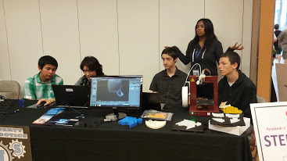
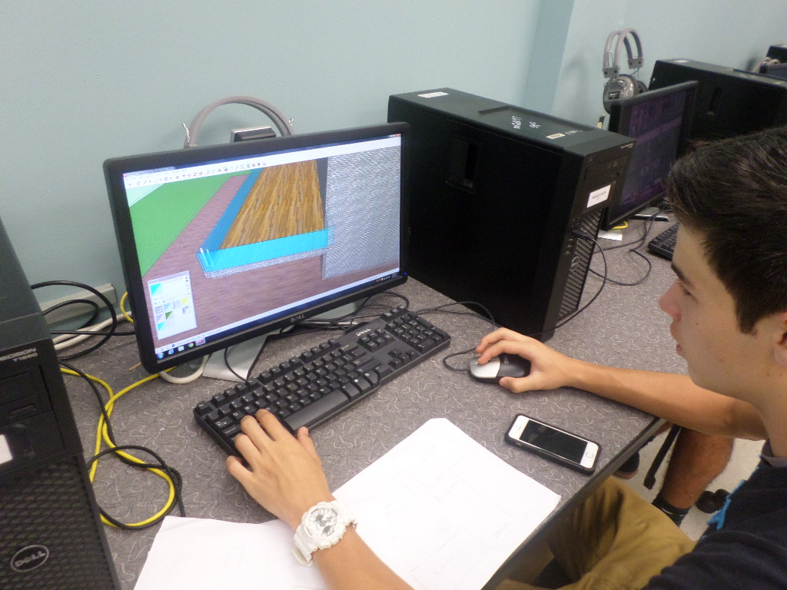
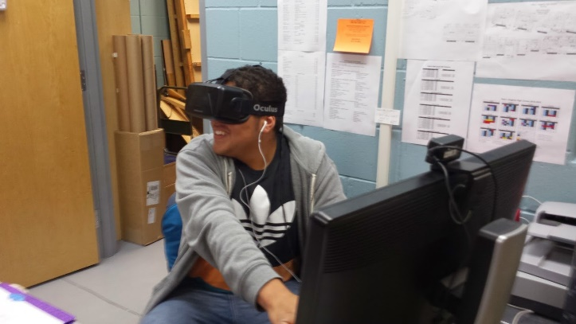
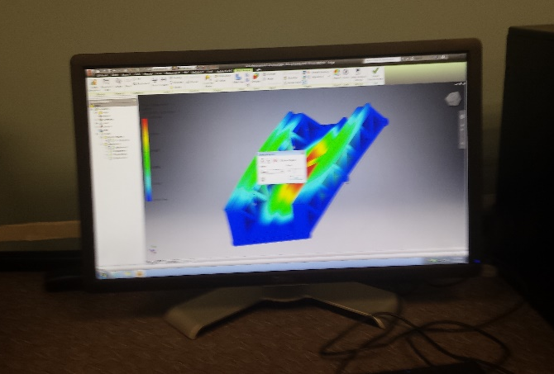
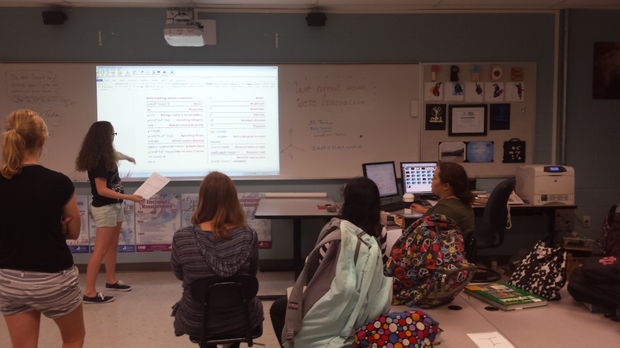
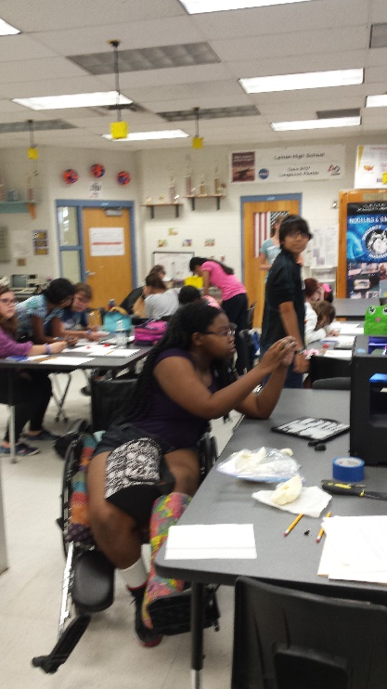
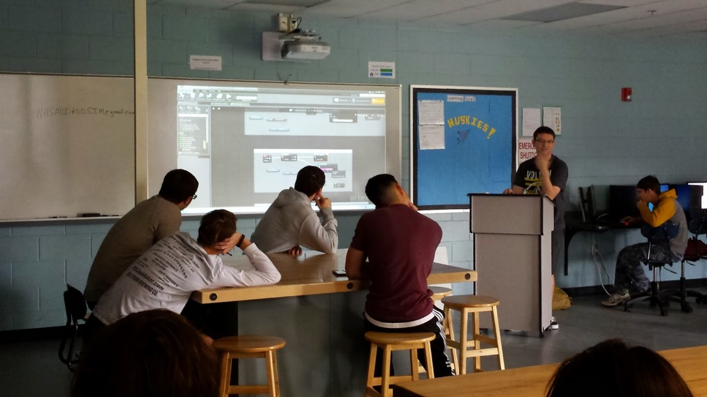
Hagerty High School Seminole County Public Schools
How we are putting the pieces together to form the Big Picture
Establish a pilot program to help Improve frameworks, curriculum and certification exam based on best practices in classroom
Milestones
2015-2016 – 182 Students
Certification exam approved by FLDOE
1 teacher /182 students
Challenged by a lack of teachers
Implemented required resources
Lynda.com – digital resource
Hands-on Mentorships
We learned the Modeling and Simulation program is unique in its ability to motivate a large learning population due to its fluid and diverse nature.
The program is a great example of an interdisciplinary STEAM learning program that offers all students from the digital artists to the computer programmers an interesting and meaningful learning experience.
We learned to make this program sustainable there is an urgency to build collaborative teams on campuses to align NCS curriculum with new frameworks and teach a successful program.
Notes:
Lindsey Spalding joined the team at the very end of year 3 (2013-2014). I worked with Stephanie Wall (SCPS CTE) to reorganize frameworks and submit to the state.
1st 2 years team worked to establish a framework and curriculum posted to the NCS web-site.

Slide 9
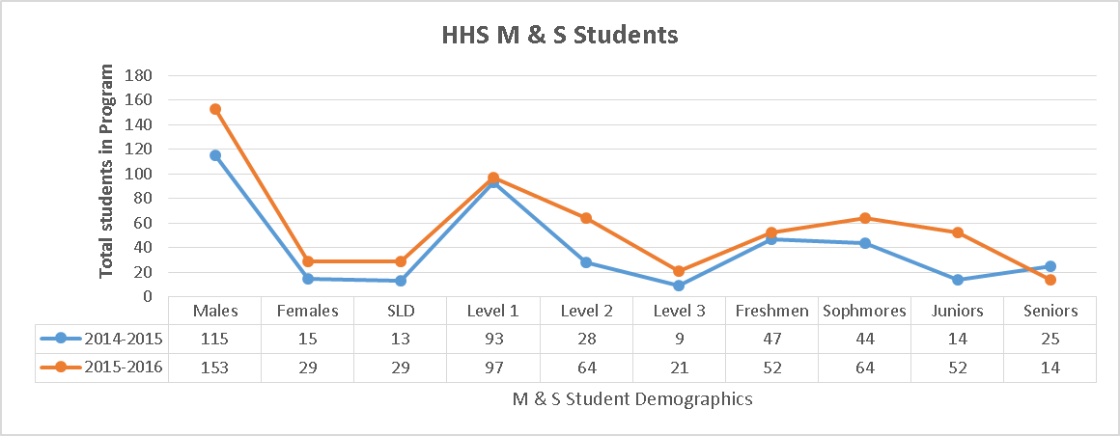
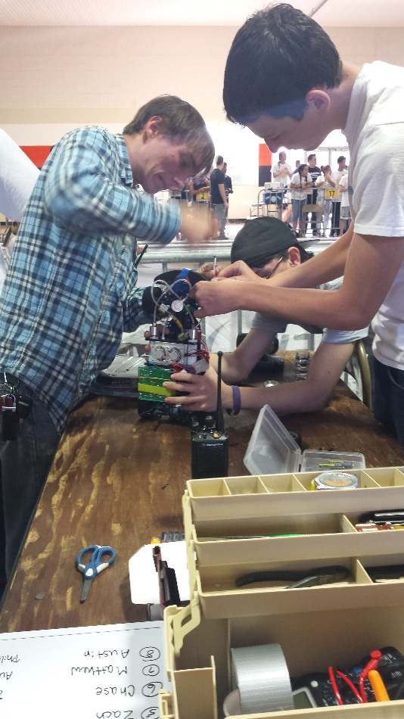
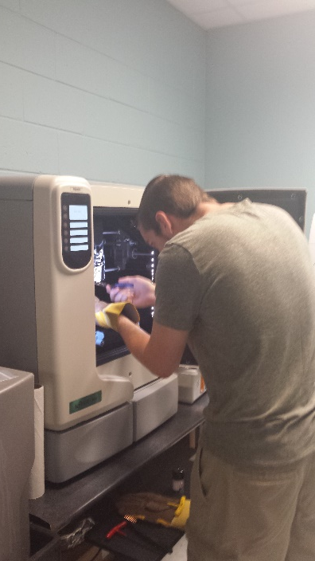
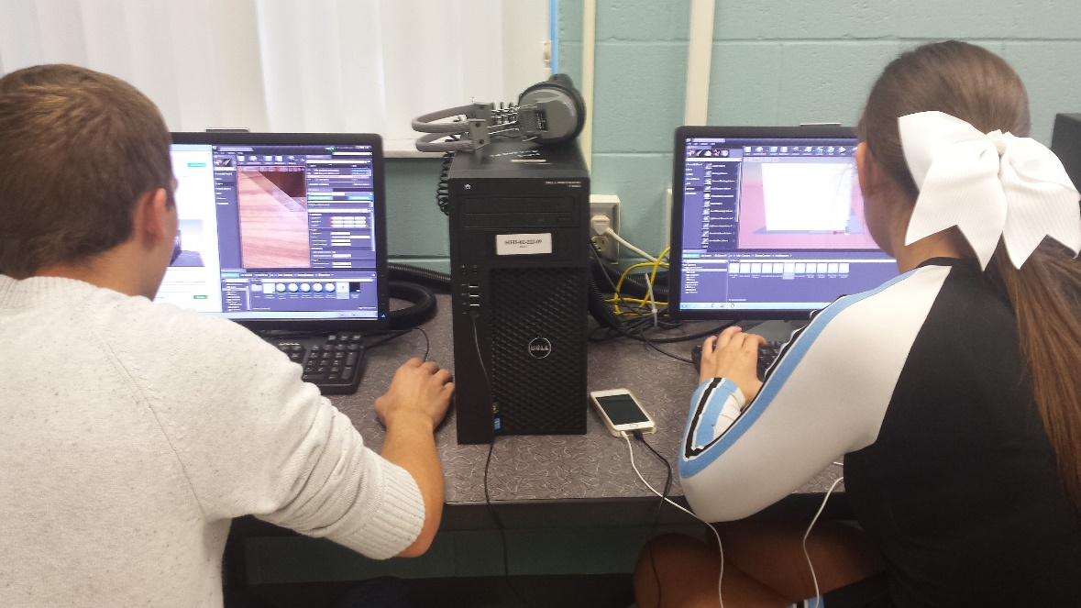
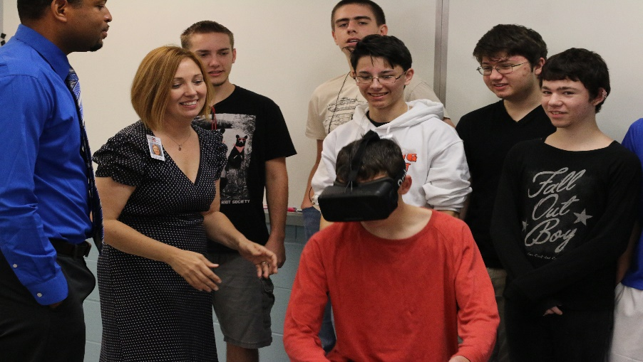
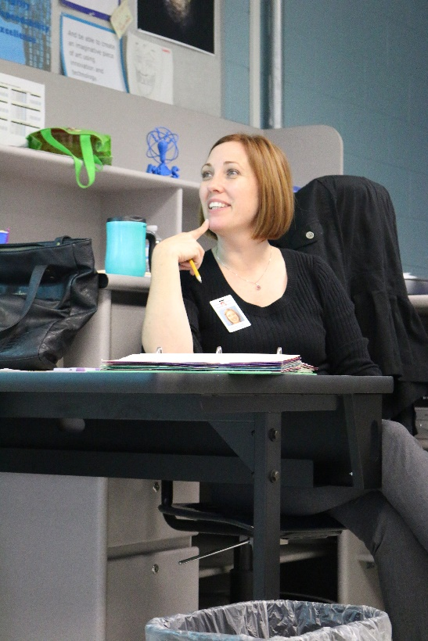
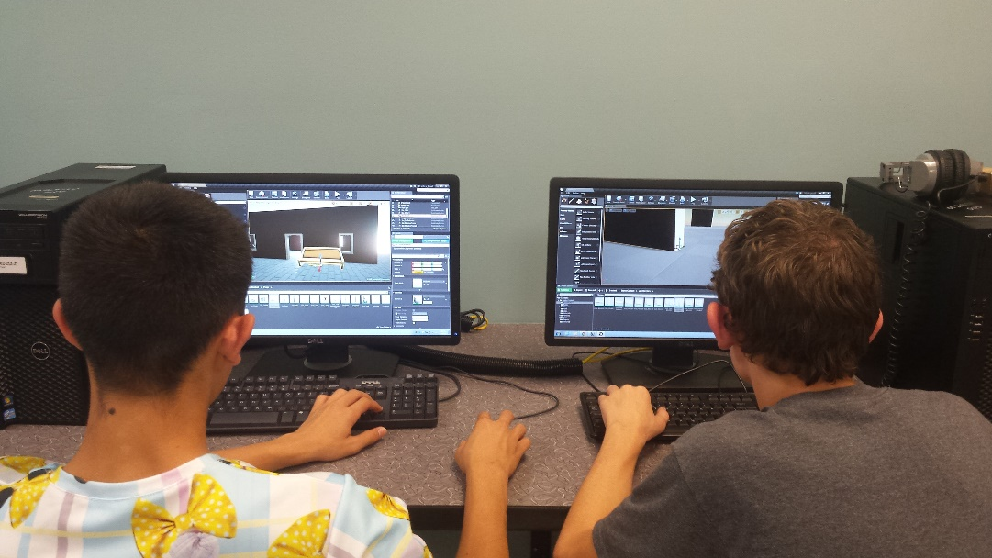
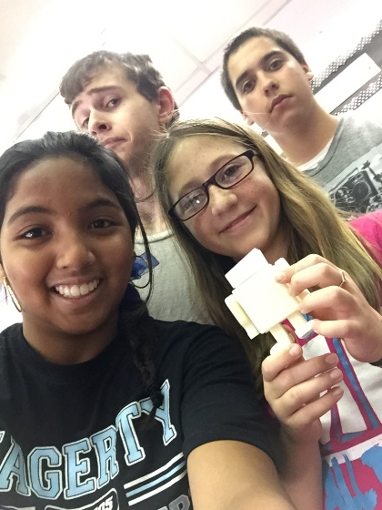
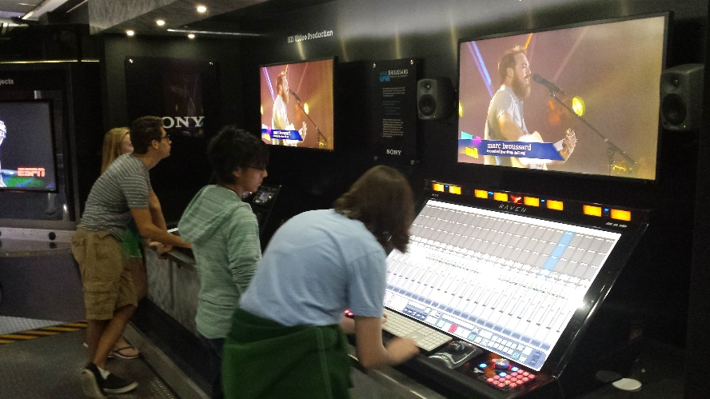
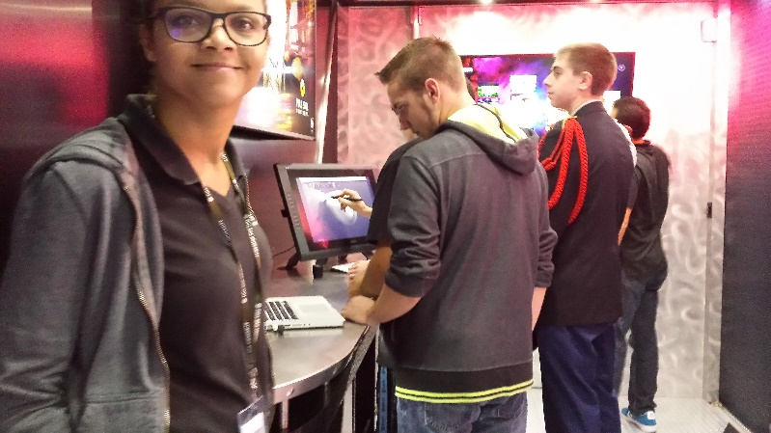
Student Demographics for Modeling and Simulation at HHS A closer look at years 4 and 5 – Who is taking Modeling and Simulation?

Slide 10
Building a Sustainable 4 year Modeling and Simulation High School Program - Update
Presented by
Lindsey Spalding
Hagerty High School
Seminole County Public Schools
407-871-0776
Lindsey_spalding@scps.k12.fl.us

Slide 11
Building a Sustainable Modeling and Simulation High School Program
Working on the Final Pieces to Finish the Model
Major Challenges | Major Successes
Establishing an effective learning environment | Created 2 learning labs that effectively support teaching and learning with M & S technologies
Keeping up with student requirements, hardware, software and industry partners * Long term Planning required to reduce challenge yearly | Students Leadership Team Digital Learning Sources Mentors in the Lab UCF MaSK club getting involved Planning with feeder middle schools to streamline e-pathway.
Increasing Female Participation | Community Outreach Club Girl Code Club Female HHS students taught a girls STEAM camp for middle school girls. Participated in feeder middle school STEAM night. Collaboration with 3D fine art teacher = AP portfolio with 3D modeling and simulation work.
Hiring Qualified Teachers | 2016-2017 (on going)
Curriculum Alignment to Frameworks | On going
Undergraduate pathway | ?
Ideal Model
Has a School based Program Director
PLC on campus with
(2-3 flexible teachers)
Curriculum aligns with frameworks
Curriculum is rigorous, diverse and supports real world problem solving
School has open lab run by Mod & Sim students for other academic areas.
An Active Business Advisory Council
Teachers and Students earn certification through NCS
Model is Shared nationally
Production of an Experienced Work force

Slide 12
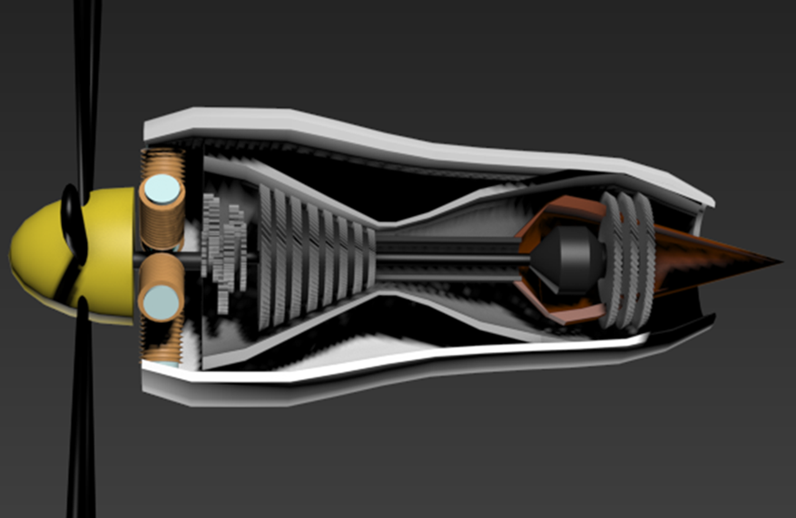
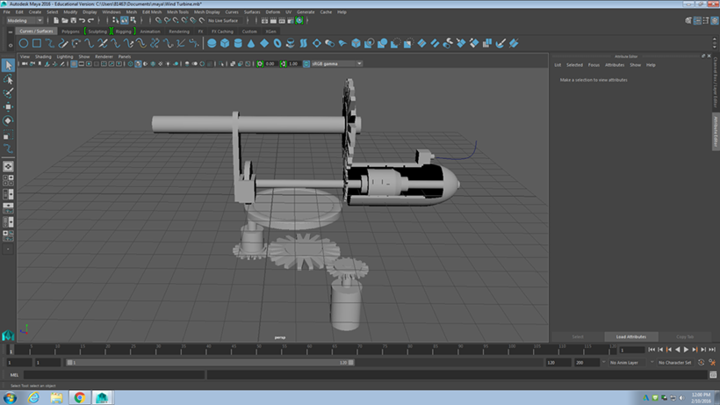
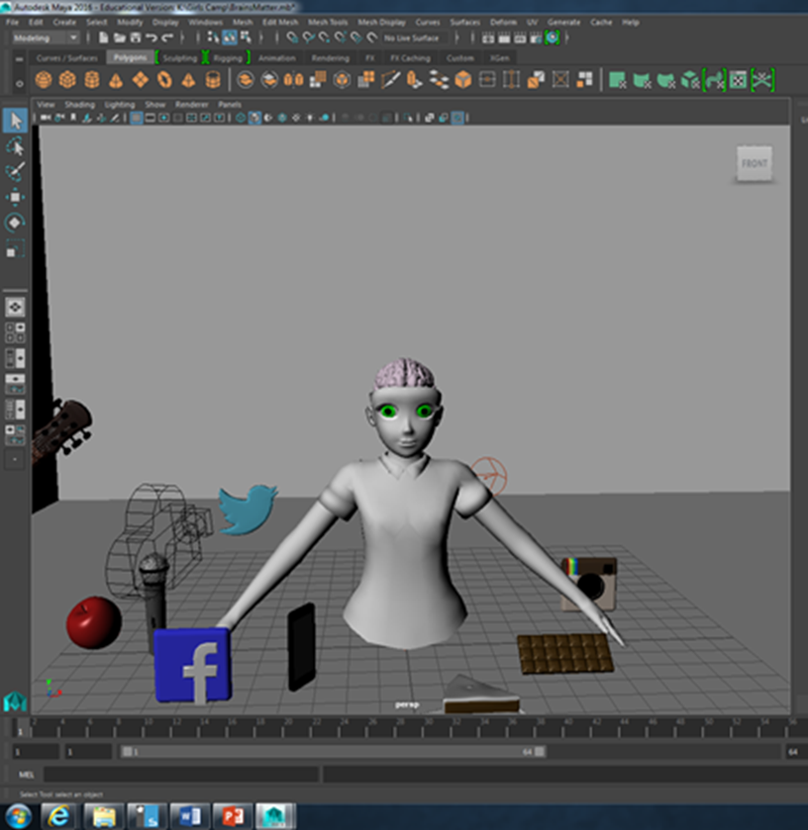
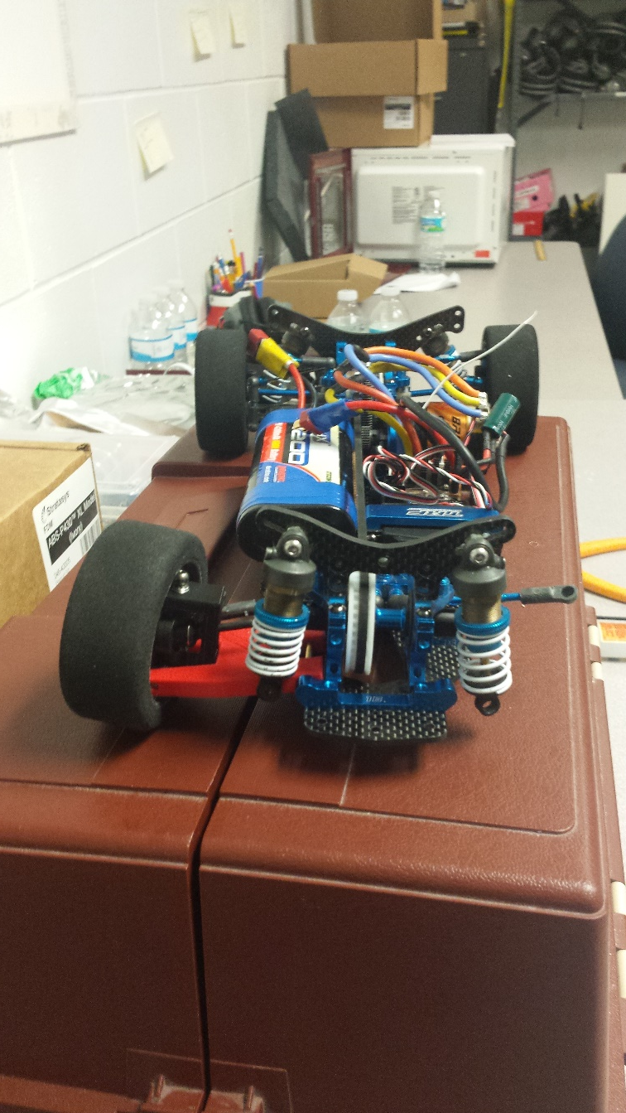
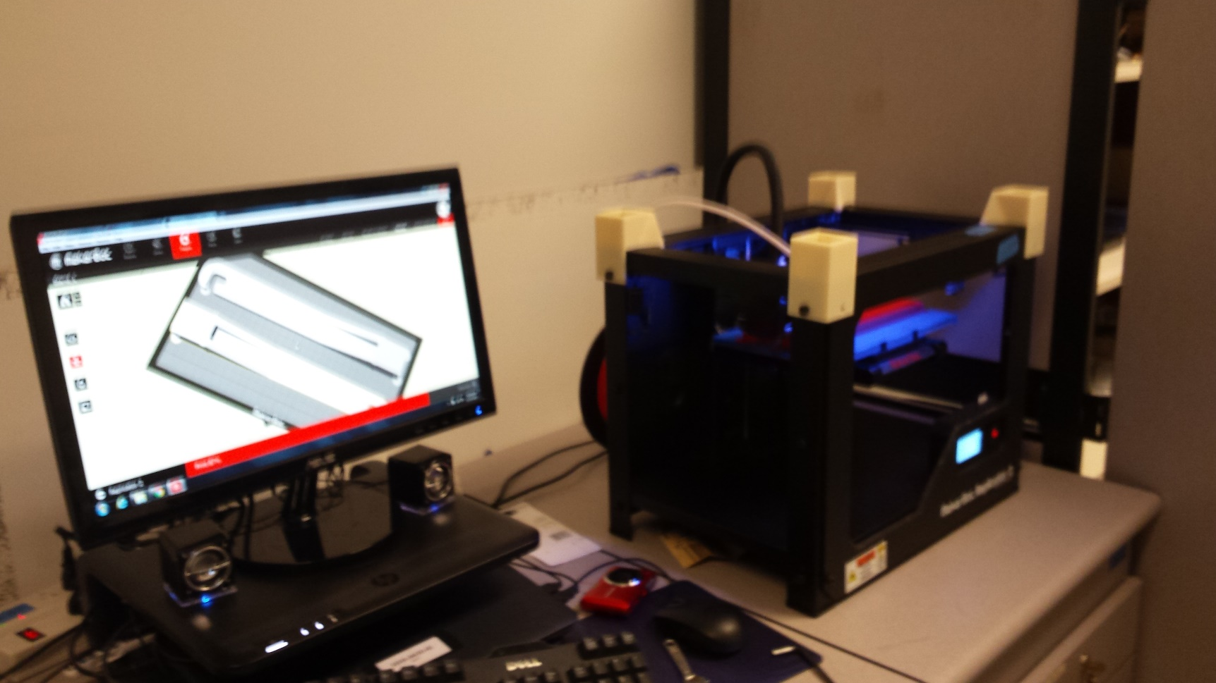
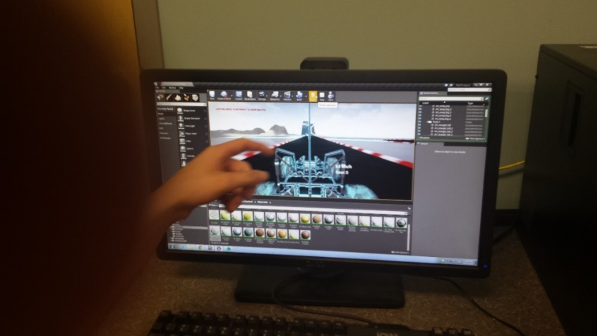
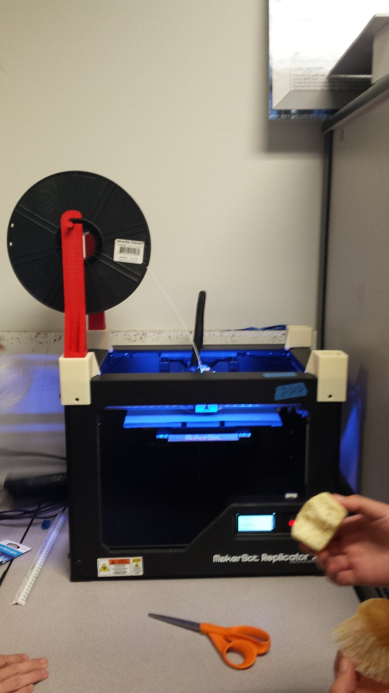
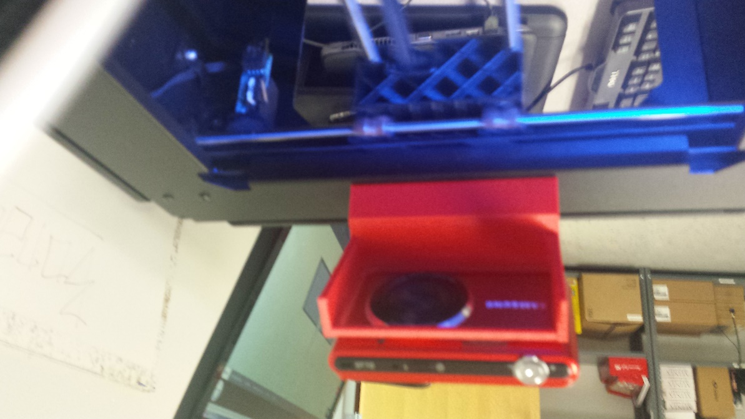
Thank You For Your Time and Efforts! Any Questions?
Lindsey Spalding
HHS Modeling and Simulation
407-871-0776
Lindsey_spalding@scps.k12.fl.us

Slide 13
