Slide 1
Education and Careers in the Aviation Industry

Slide 2
Industry Overview
In the U.S. alone, there is an average of 43,864 flights daily with 5,000 aircraft in the sky at any given time.
1
This means there are over 100,000 pilots employed at any given time in America.
2
It’s estimated that more than 42% of active pilots will retire in the next 10 years.
3
The industry will need 637,000 new pilots.
4
That is 87 per year or one every 15 minutes!

Slide 3
Simulation in Aviation
Emergence of v/r
Alternative to subsidize simulators.
Crew Members can go through the entire pre-flight process of aircraft walk around, checking for malfunctions or problems, and locating safety equipment inside.
Simulation games
Multi-pilot license (MPL)
Allows pilots to act as a co-pilot in an aircraft required to be operated with a co-pilot on commercial air transport with only a single-pilot rating, a theoretical course, and skill test.

Slide 4
Role of Simulation in Training
Pilot Training and Checking
Cabin Crew Training
Maintenance Training

Slide 5
Pilot Shortage
Several key causes:
Mandated retirement age of 65
Fewer new pilots entering the industry
Military is producing fewer pilots
1500 Hour Rule

Slide 6
Potential Outcomes of Pilot Shortage
More bankruptcies.
Republic filed in Feb 2016 citing pilot shortage as a factor.
Elimination of service to smaller cities.
Estimated 2/3 of today’s regional fleet being parked.

Slide 7
Careers in Aviation
Maintenance
Engineering
ATC
Marketing and Social Media
Computer Science and Computer Software
Cabin Crew
Scheduling
Aircraft Manufacturing
Aircraft Design
Compliance and Regulations
Operations
Simulation

Slide 8
Doing Our Part (WATS)
Brings together the global aviation training community and delivers five conference streams alongside the sector’s biggest tradeshow.
02
The exposition hall is where you’ll be able to see the newest technology and fly the latest training devices.
03
The World Airline Training Summit, dedicated solely to the future of the airline industry.
01

Slide 9
The Next Generation-SECA
Specifically designed for High School and College students
Get key insights into where the industry is going, explore opportunities, and how you can prepare yourself to join this exciting industry.
Have face time with the employees of some of the world’s top aviation employers.
Hear first-hand how they got into the industry and what steps you can take to break into the industry yourself.
Converse with hundreds of airline experts from a variety of positions from around the world.

Slide 10
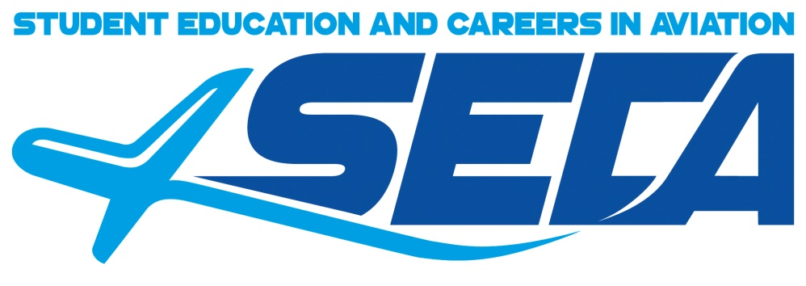
Contact Information
For more information on SECA please contact:
Michelle Viens
Michelle@halldale.com
407- 322- 5605

