Slide 1
Modeling & Simulations Teachers Seminar: Demonstrating Computer Skills
Phil Tillery
Game & Simulations Design Instructor
Orlando Technical Center
September 26, 2013

Slide 2
Unit 2: Unit Length
Unit Length:
This unit will last approximately 10 days but objectives will be reinforced throughout the course.
Goals:
Demonstrate knowledge, skill, and application of information systems to accomplish job objectives.
Rationale:
Computer skills are a basic fact of life for most workers. Even if you don’t work with computers in order to complete your primary work duties, it is likely that you run into them from time to time. In fact, most jobs, from supermarket management to restaurant service, require basic computer knowledge. And more and more jobs are demanding that workers become increasingly familiar with and comfortable using a wide range of computer applications.

Slide 3
Objectives (Standards):
1. Demonstrate knowledge of different operating systems.
2. Demonstrate proficiency navigating the Internet, intranet, and the WWW.
3. Demonstrate proficiency using HTML commands.
4. Manipulate file structures.
5. Develop an awareness of microprocessors and digital computers.
6. Develop an awareness of the information technology industry.
7. Develop an awareness of programming languages.
8. Develop an awareness of emerging technologies.
9. Demonstrate proficiency using common software applications.
10. Demonstrate proficiency in computer skills.
11. Identify hardware constraints on simulations including processors and I/O devices.
12. Identify computer components and their functions.
13. Develop and apply spreadsheet skills.

Slide 4
Unit 2.1: Basic Computer Skills
Rationale:
If you are longing to move up in your future job or if you are interested in moving into a new career, you may be wondering what computer skills you will need to accomplish these goals. Well, as computers become more and more important in most workplaces, computer skills are often the greatest asset a worker can possess. And though you may be able to get your work done with basic computer know-how, in order to really succeed in the workforce it is important to have some complex computer skills. Reaching complex computer skills requires that you have exceptional basic computer skills.

Slide 5
Recommended Instructional Activities

Slide 6
Review computer history timeline.
Have students clean and secure their workspace daily.
Other students should supervise, thus giving them an opportunity to lead and be led.
Open, edit, and save a word and other application files such as Excel.
Locate and print to a remote classroom printer.
Require students to backup data daily.

Slide 7
Recommended Instructional Activities:
Computer History Timeline
http://www.computerhistory.org/timeline/?category=cmptr (see next slide)
http://www.datesandevents.org/events-timelines/07-computer-history-timeline.htm (see slide 6)

Slide 8
http://www.computerhistory.org/timeline/?category=cmptr

Slide 9
http://www.datesandevents.org/events-timelines/07-computer-history-timeline.htm

Slide 10
Read, Pair, and Share Activities
Essentially, the twenty-four Read, Pair, and Share Activities are centered around getting use to using Microsoft Word & Exel.

Slide 14
Design Brief: Design a Computer Network

Slide 15
Challenge
Each student will demonstrate an understanding of a computer network by using a graphical diagramming program, such as Word to graphically show the arrangement of network components.
Basic network diagrams must show the primary pieces of your network and how those pieces are connected.
When choosing a network type (topology), four things should be considered: Cost, expandability, location of PC’s, and speed.

Slide 16
Learning Goals or Objectives:
Upon completion of the design brief, students will be able to:
Identify computer network components.
Identify basic types of topologies.
Apply technology to communicate and collaborate.
Describe a LAN and WAN.
Discuss the differences between an Internet and Intranet.

Slide 17
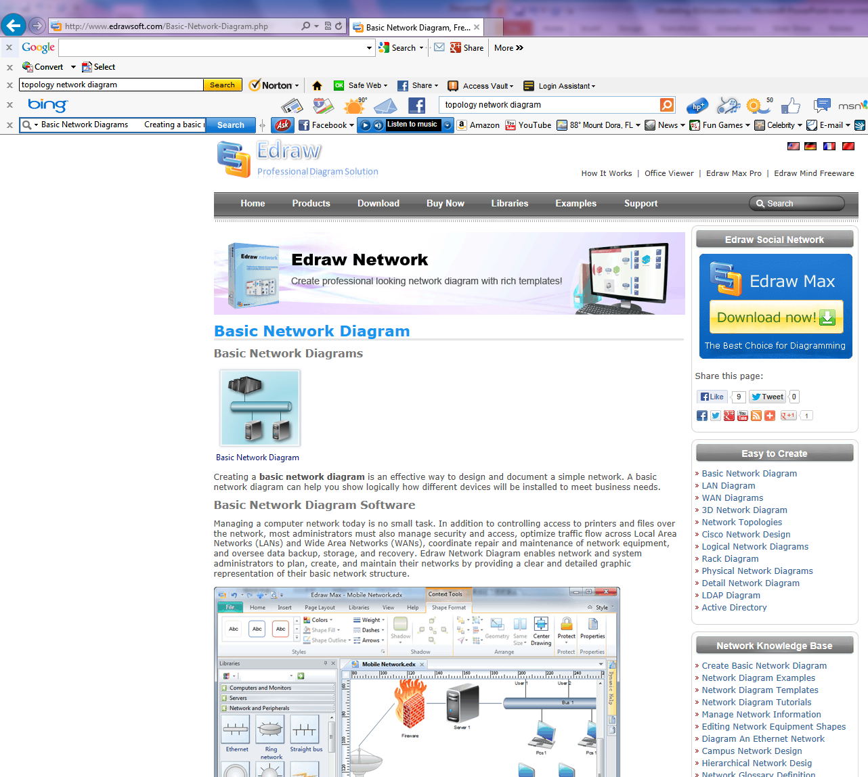
http://www.edrawsoft.com/Basic-Network-Diagram.php

Slide 18
HUB
Computer
Computer
Printer
Computer
Computer

Slide 19
LAN—Local Access Network
LAN: “Local Access Network”. This refers to a computer network (two or more computers connected together), cabled or wireless, in an area of restricted size, usually a home or office.

Slide 20
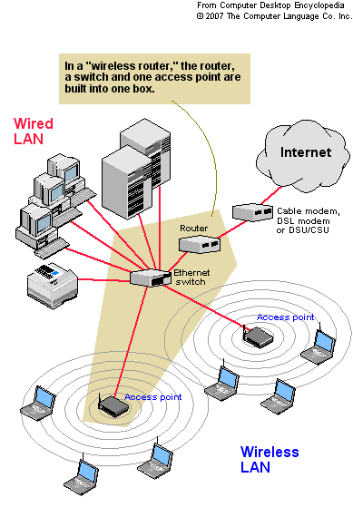

Slide 21
WAN—Wide Area Network
WAN: “Wide Area Network”. Refers to a computer network of unrestricted size, usually an ISP (Internet Service Provider) that serves thousands of local users and networks. If you have cable or DSL, you’re connected to a WAN.

Slide 22
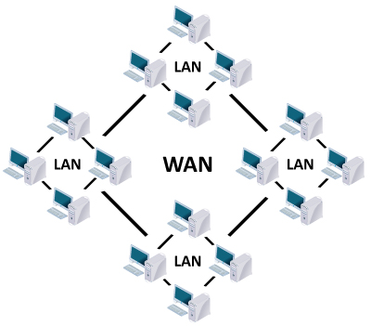

Slide 23
Internet
The Internet is a global system of interconnected computer networks that use the standard Internet protocol suite (TCP/IP) to serve several billion users worldwide. It is a network of networks that consists of millions of private, public, academic, business, and government networks, of local to global scope, that are linked by a broad array of electronic, wireless and optical networking technologies.

Slide 25
Intranet
An intranet is a computer network that uses Internet Protocol technology to share information, operational systems, or computing services within an organization. This term is used in contrast to internet, a network between organizations, and instead refers to a network within an organization. Sometimes, the term refers only to the organization's internal website, but may be a more extensive part of the organization's information technology infrastructure, and may be composed of multiple local area networks. The objective is to organize each individual's desktop with minimal cost, time and effort to be more productive, cost efficient, timely, and competitive.

Slide 26
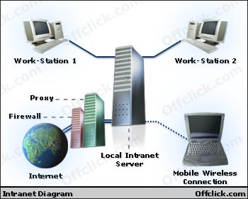

Slide 27
Evaluation

Slide 28
You have tow or more computers. How do you connect them to share files and printers?
You need a home network. First stat by selecting a cabling method—Ethernet, wireless, PhoneLine, etc.
What is the most popular network type for both home and business?
Ethernet
What is Bandwidth:
Every line has an upper limit and lower limit on the frequency of signals it can carry.
This limited range is called the bandwidth.
What is MAC address?
The address for a device as it is identified at the Media Access Control (MAC) layer in the network architecture. MAC address is usually stored in ROM on the network adapter card and is unique.

Slide 29
Resources
Software

Slide 30
Microsoft
Word
Excel
Reports
Spread Sheets

Slide 31
2 Dimensional
Adobe Illustrator
Adobe Photoshop
Line drawing
Photos

Slide 32
3 Dimensional
Blender
Autodesk 3dsMax or Maya
Freeware
Yearly license
Maxon Cinema4D

Slide 33
Game Engine
Unity
Unity Pro
Freeware
http://unity3d.com/unity/download/
About $1500.00
http://unity3d.com/unity/download/

