Slide 1
New Simulation Specializations for AS and BS Degrees
Dr. Bill Gaught, Program Manager/Professor

Slide 2
Simulation Specializations to be offered Fall 18 Term
AS Computer Programming and Analysis (12 credits in simulation)
transfers directly into BS Information Systems Technology degree
AS and BS Engineering Technology (21 credits in simulation) (delayed)
BS Information Systems Technology (6 credits in simulation)
Students earning the AS in Computer Programming and Analysis who transfer into the BS IST degree will graduate with 18 total credits in simulation
Note: at Seminole State College the AS degree is built into our BS degrees. Students earn the AS degree halfway through their BS degree.

Slide 3
AS Computer Programming and Analysis
Required Courses 30 CREDITS
CET1179 | Network Concepts & Operating Systems | 3
COP1000 | Principles of Computer Programming | 3
COP2800 | Programming in Java (OOP) | 3
COP2805 | Advanced Programming in Java (algorithms and data structures) | 3
COP2830 | Web Programming 1 | 3
CGS2100C | Computer Applications | 3
CGS2545C | Database Management | 3
CIS2321 | Systems Analysis and Design | 3
CTS2445 | Oracle Structured Query Language (SQL) | 3
 | Choose 1:
CIS2901C | Case Study in Business Programming | 3
 | OR
COP2949 | Cooperative Education Internship | 3
Specialization Tracks 12 CREDITS
NEW | BS IST Simulation Specialization Track
CAP2801 | Simulation and Gaming Fundamentals I | 3
CAP2804 | Simulation and Gaming Fundamentals II | 3
COP2224 | C++ Programming | 3
CAP1760 | Introduction to Data Analytics | 3
 | BS IST Programming Specialization Track
 | Choose 12 credits from list of courses below
COP2224 | C++ Programming | 3
COP2360 | C# Programming | 3
COP2047 | Python Programming | 3
COP2836 | Web Programming 2 | 3
CAP1760 | Introduction to Data Analytics | 3
 | Web Development Specialization Track
 | Choose 12 credits from list of courses below
COP2047 | Python Programming | 3
COP2831 | Web Scripting and AJAX | 3
COP2833 | Data Driven Websites | 3
COP2836 | Web Programming 2 | 3
CEN2724 | User Interface and User Experience Design | 3
General Education 18 CREDITS
ENC1101 | English 1 | 3
ENC1102 | English 2 | 3
Social Science General Education Course |  | 3
Humanities General Education Course |  | 3
Mathematics General Education Course |  | 3
SPC1608 Introduction to Oral Communication |  | 3
TOTAL DEGREE CREDITS 60 CREDITS
Notes: Simulation Specialization Track starts Fall 2018

Slide 4
BS Information Systems Technology
GENERAL EDUCATION 36 CREDITS
ENC 1101 | English I | 3
ENC 1102 | English II * | 3
SPC 1608 | Intro to Oral Communication * | 3
MAC 1105 | College Algebra or higher level MAC prefix course* | 3
STA 2023 | Statistical Methods I or higher level statis- tics course; or MAC 1114 Trigonometry or higher level mathematics course** | 3
ECO 2013 or ECO 2023 | Principles of Economics (MACRO)* Principles of Economics (MICRO)* | 3 3
Social Science |  | 3
Humanities |  | 6
History |  | 3
Science |  | 6
BS IST UPPER DIVISION 45 CREDITS TOTAL
Core Courses (27 credits)
CDA 3100 | Introduction to Computer Architecture | 3
CNT 4504 | Computer Networks and Distributed Processing | 3
COP 3703 | Database Design/Architecture | 3
CIS 3360 | Principles of Security | 3
COT 3103 | Discrete Computational Analysis | 3
CET 3505 | Computer Operating Systems | 3
ISM 3113 | Information Systems Analysis and Design | 3
ISM 4314 | Project Management | 3
CIS 4891 | Capstone Project | 3
Simulation Track (18 credits) NEW
CEN 3024 | Software Development I | 3
CEN 4025 | Software Development II | 3
CEN 4333 | Advanced Database Development | 3
CEN 4802 | Software Integration, Configuration, Testing | 3
COP 3XXX | Simulation Software Design | 3
COP 3XXX | Continuous Simulation | 3
ELECTIVES | 6 CREDITS TOTAL | 6
 | Elective Courses (any upper or lower division) | 6
BS IST PREREQUISITES (all tracks) 12 CREDITS
 | CET 1179 | Network Concepts and Operating Systems** | 3
 | CET 1600C | Cisco Networking Fundamentals ** | 3
 | COP 1000 | Principles of Computer Programming | 3
 | CGS 2545C | Data Base Management** | 3
Prog ra mmi ng Spe cializ atio n 9 CREDITS
 | COP 2800 | Programming in Java | 3
 | COP 2805 | Advanced Programming in Java | 3
 | CGS 2100 | Office Applications | 3
ELECTIVES 12 CREDITS
Electives | Any College Credit Course (excluding courses with a number beginning with zero) | 12
Total Credits: 120

Slide 5
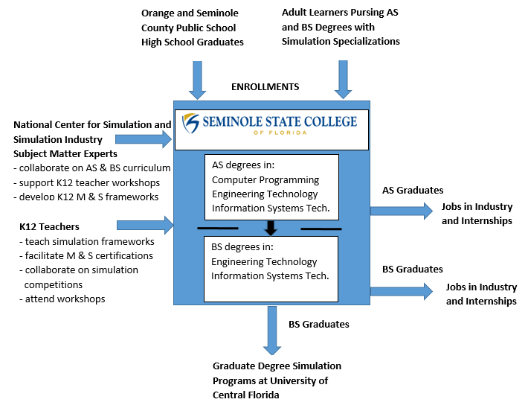
Collaboration Pathway for Education and Simulation Industry

Slide 6
Earn Bachelor of Science (BS) in Information Systems Technology
Earn Master of Science (BS) in Modeling and Simulation

Slide 7
Questions?
Contact: Dr. Gaught, gaughtw@seminolestate.edu

