Slide 1
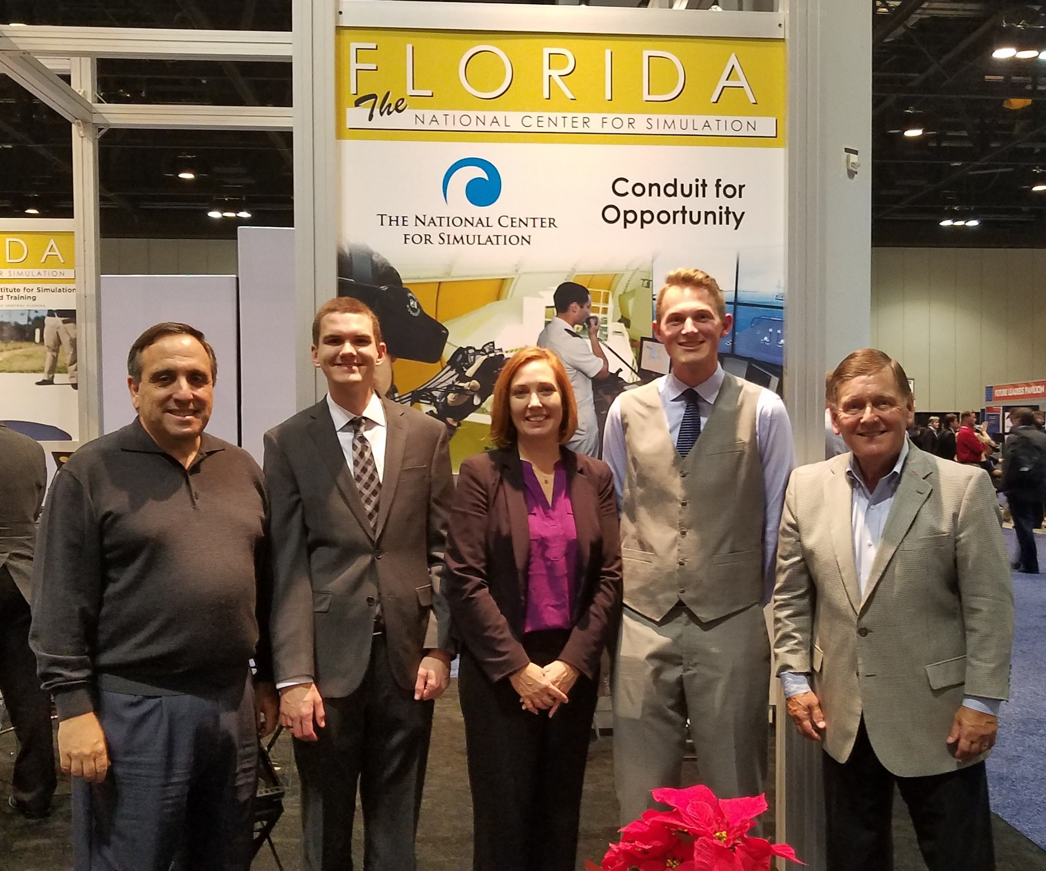
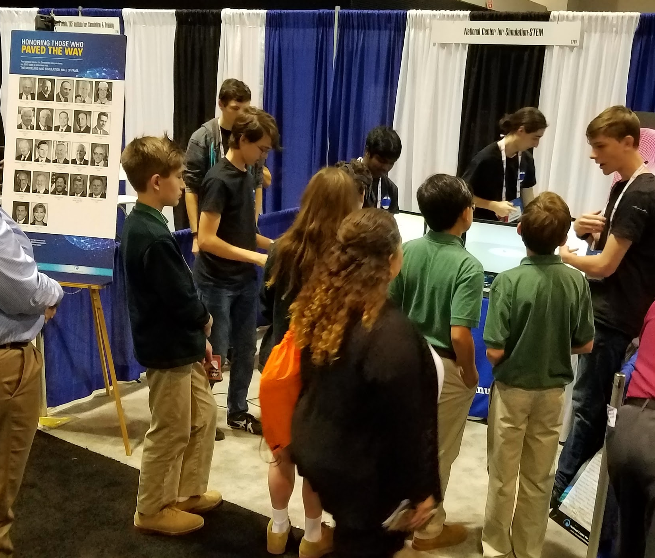
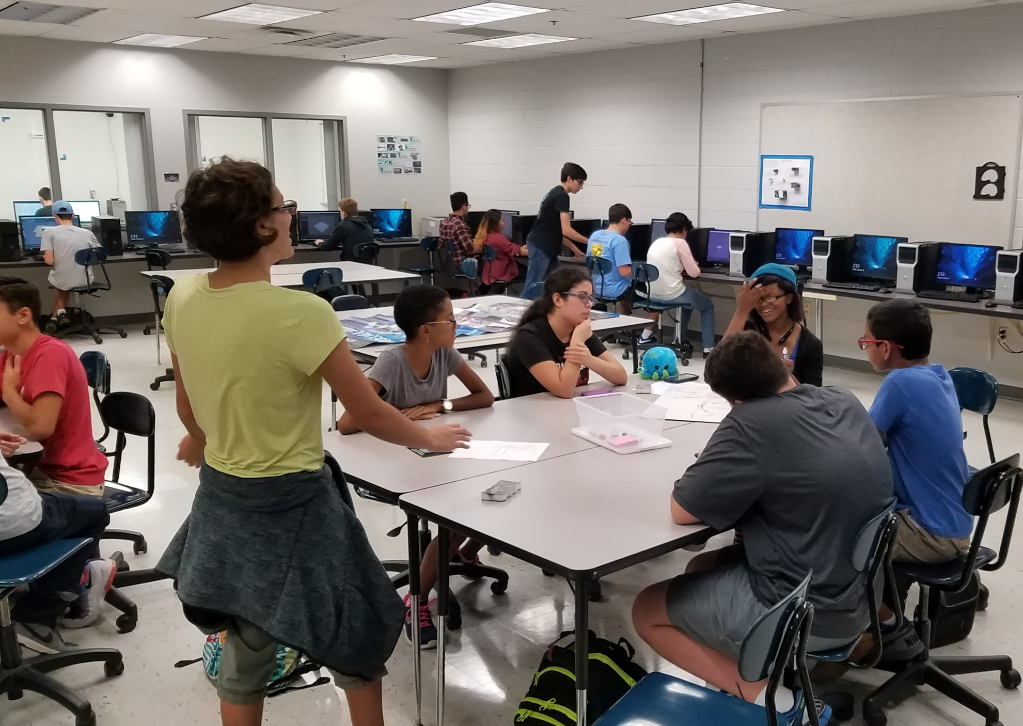
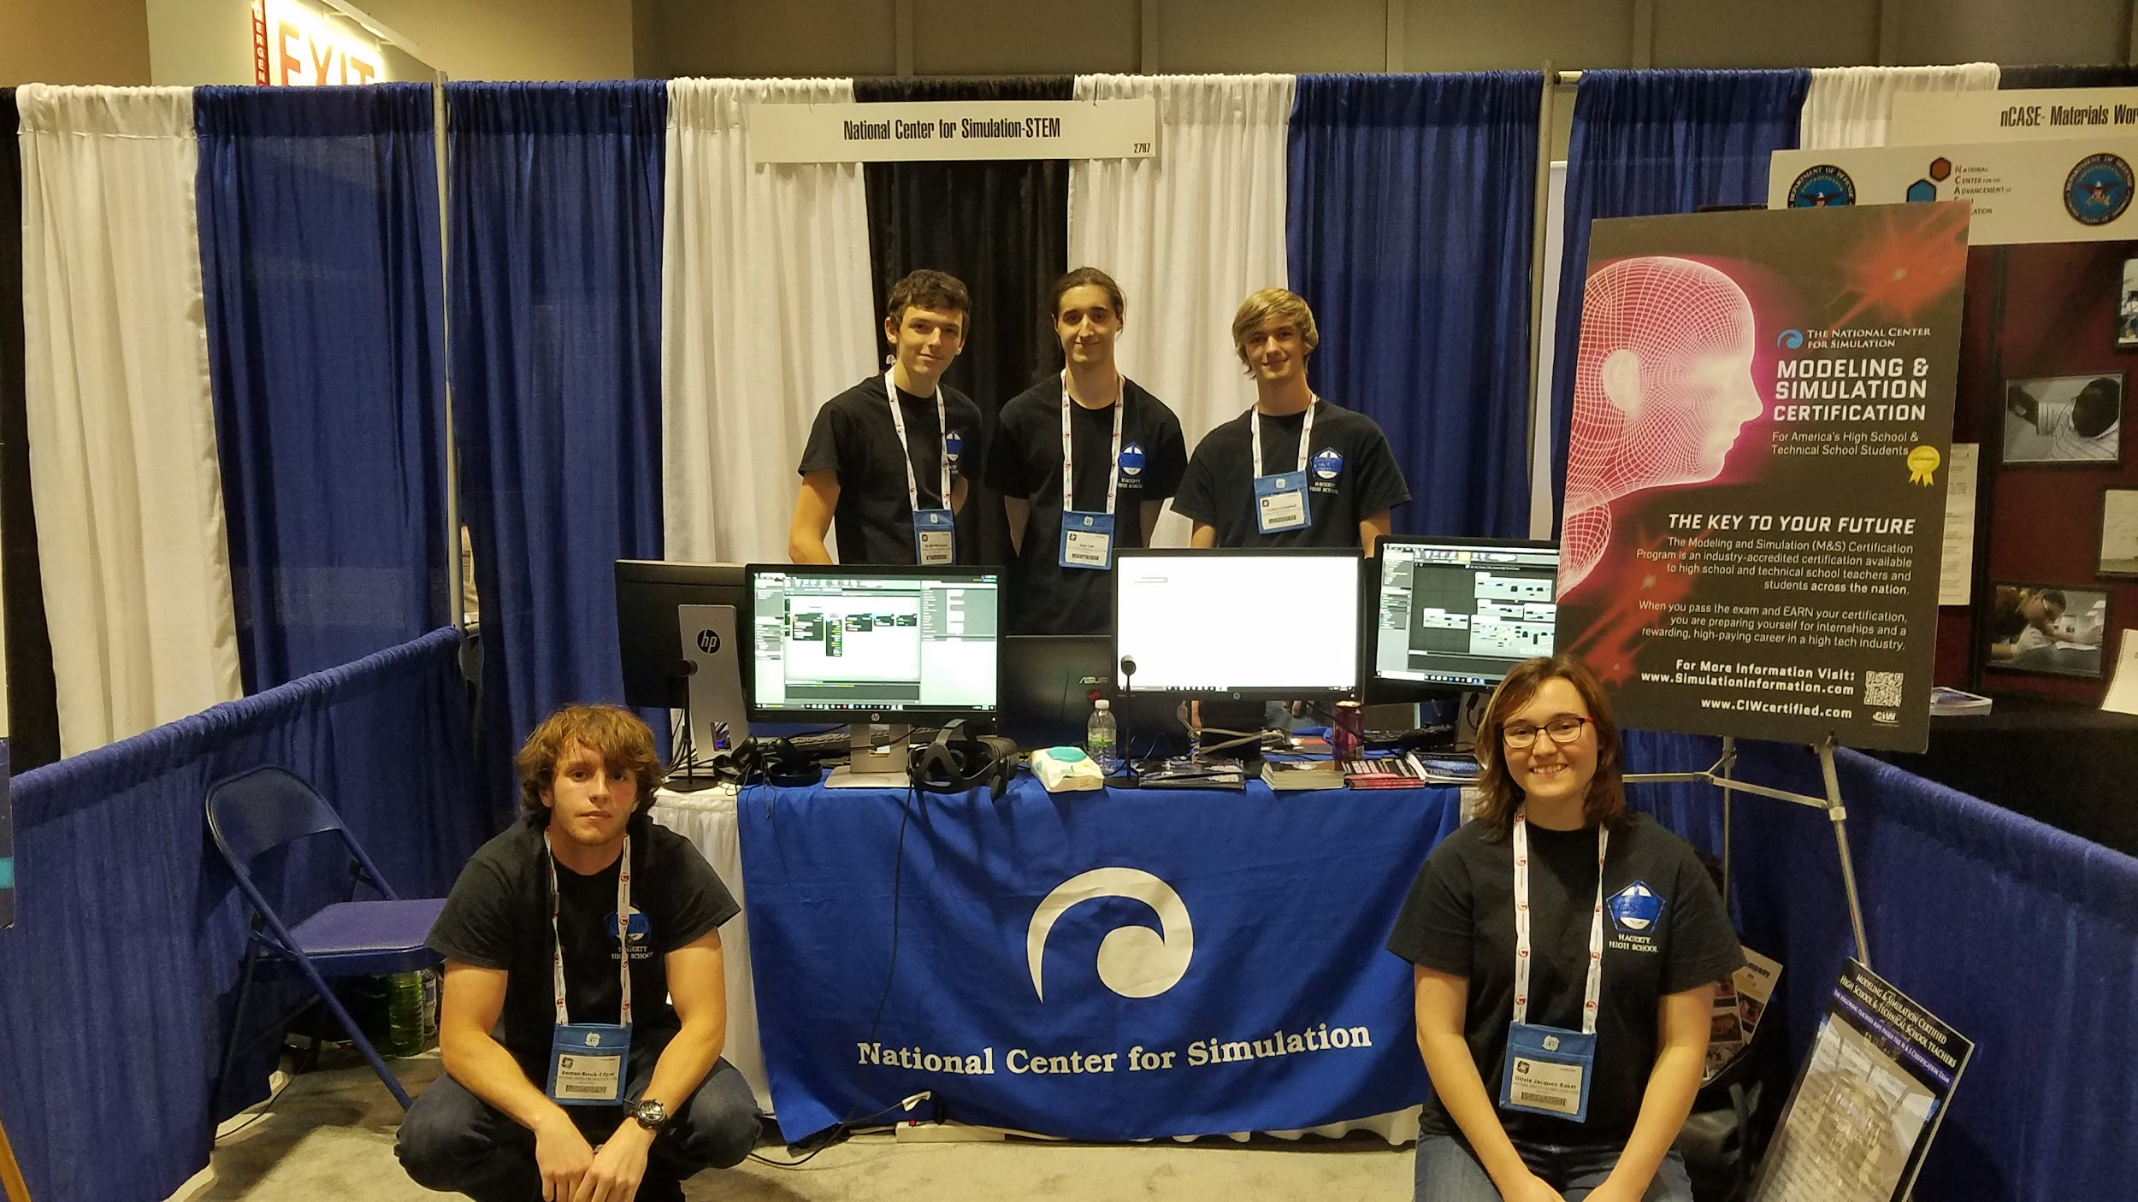
Hagerty High School Modeling and Simulation
2017-2018 Program Update
Lindsey Spalding
Lindsey_spalding@scps.k12.fl.us

Slide 2
The Logistics of Career Technology Education (CTE) Programs in 9 -12 Public Education
Electives
Teacher must advertise to fill a class/programs
Not enough students = No class or Program
Not a Problem for HHS Mod & Sim
CAPE - Career and Professional Education
Qualifications and Requirements
Main source of funding for Programs
HHS Mod & Sim is a CAPE Academy
Earned $14,000.00 from 2016-2017 students passing NCS Exam
Larger amount anticipated for next year - 28/38 (73%) Passed 2018 Exam

Slide 3
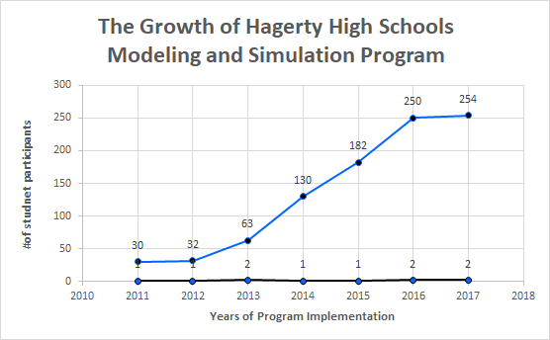
# of Students
# of Teachers
2018 -2019 student numbers not released yet - expectation is close to 260 students and 2 teachers.

Slide 4
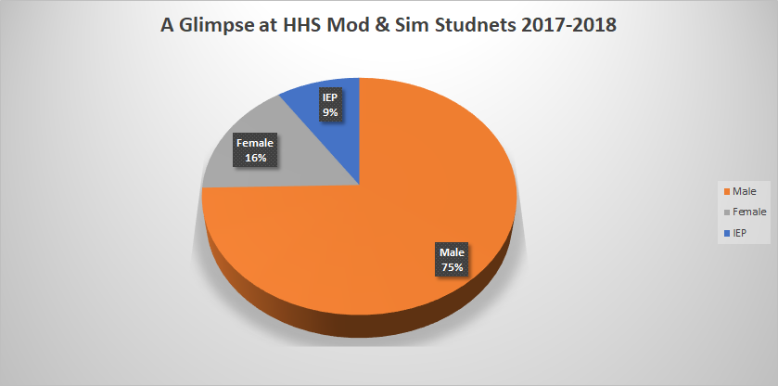

Slide 5
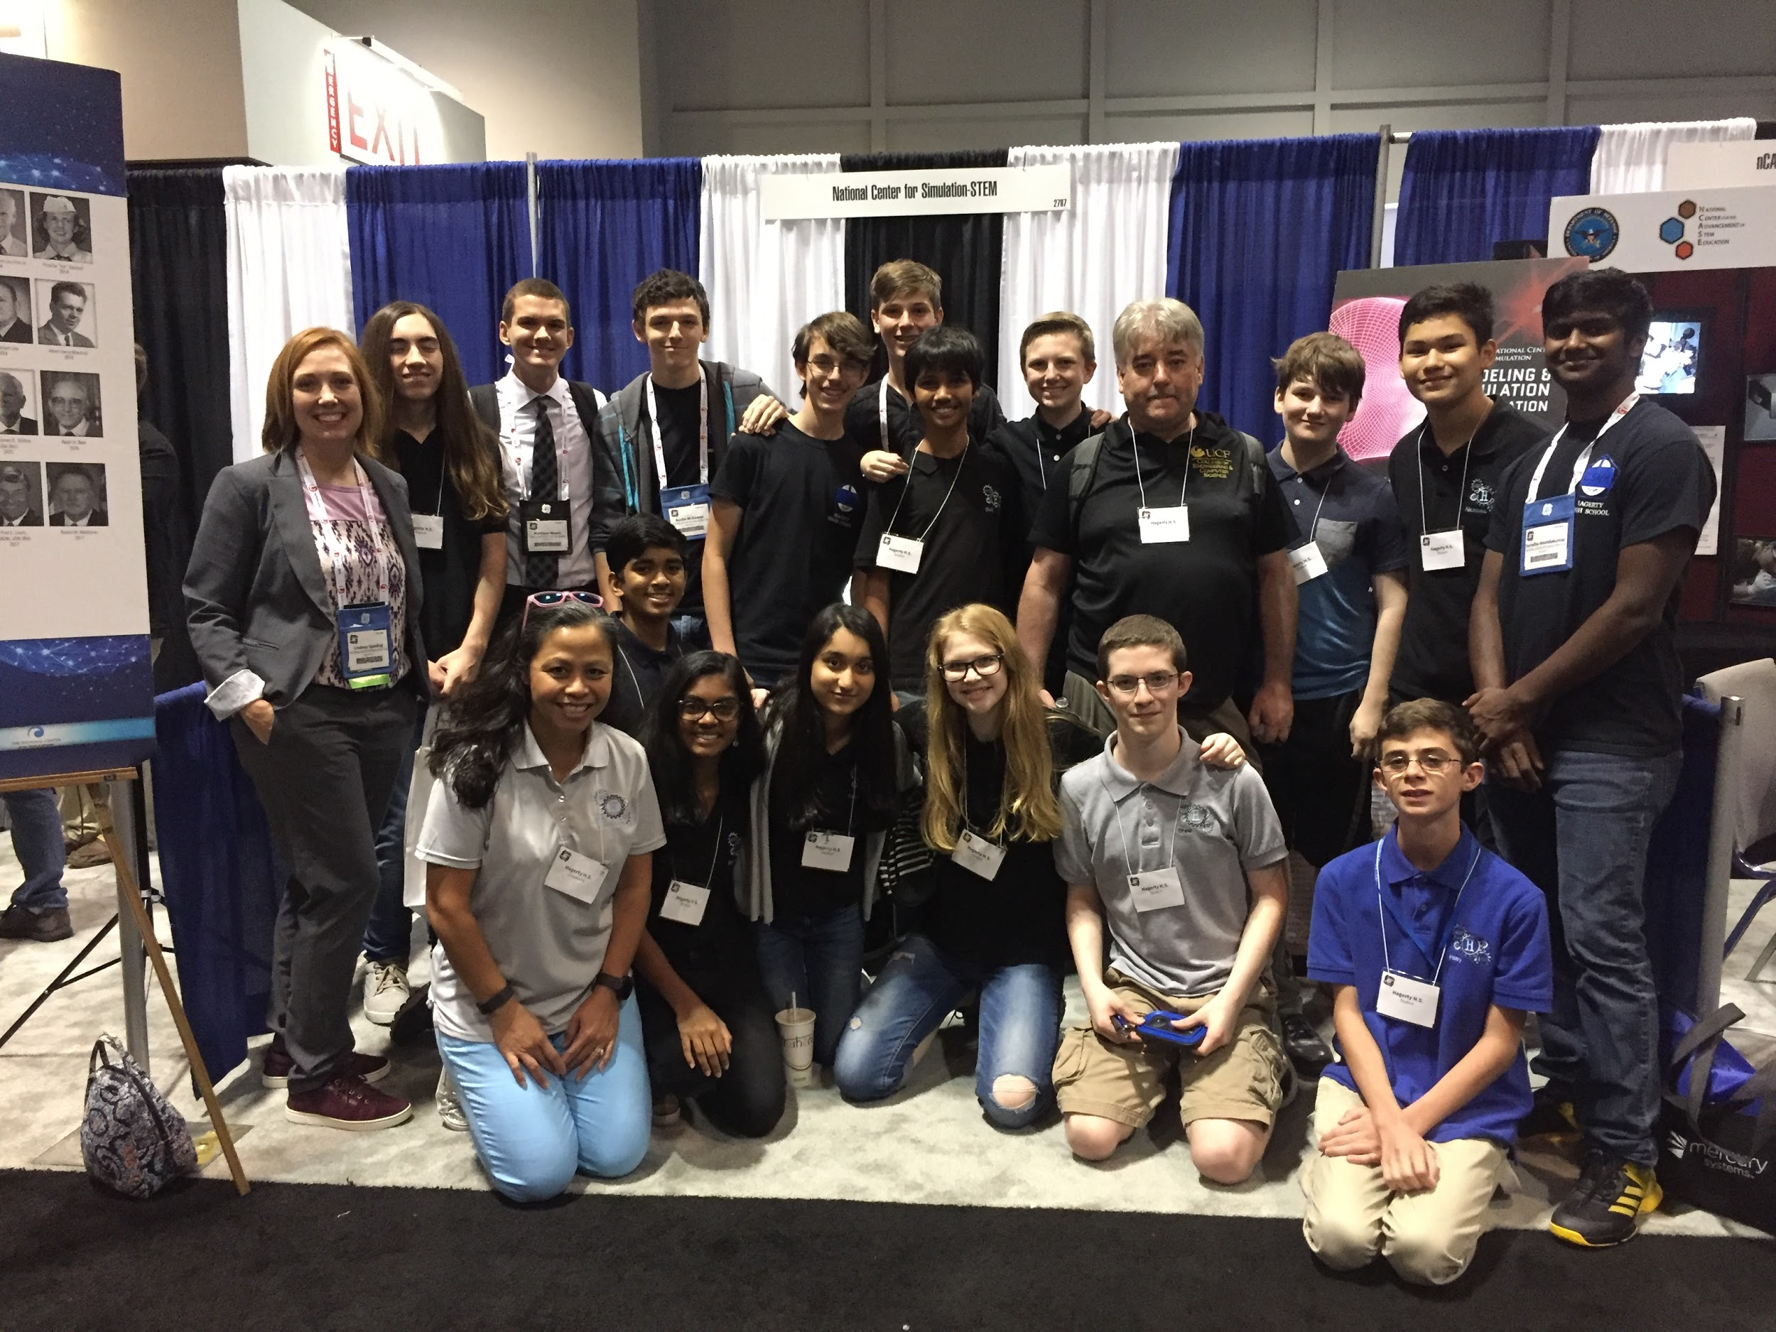
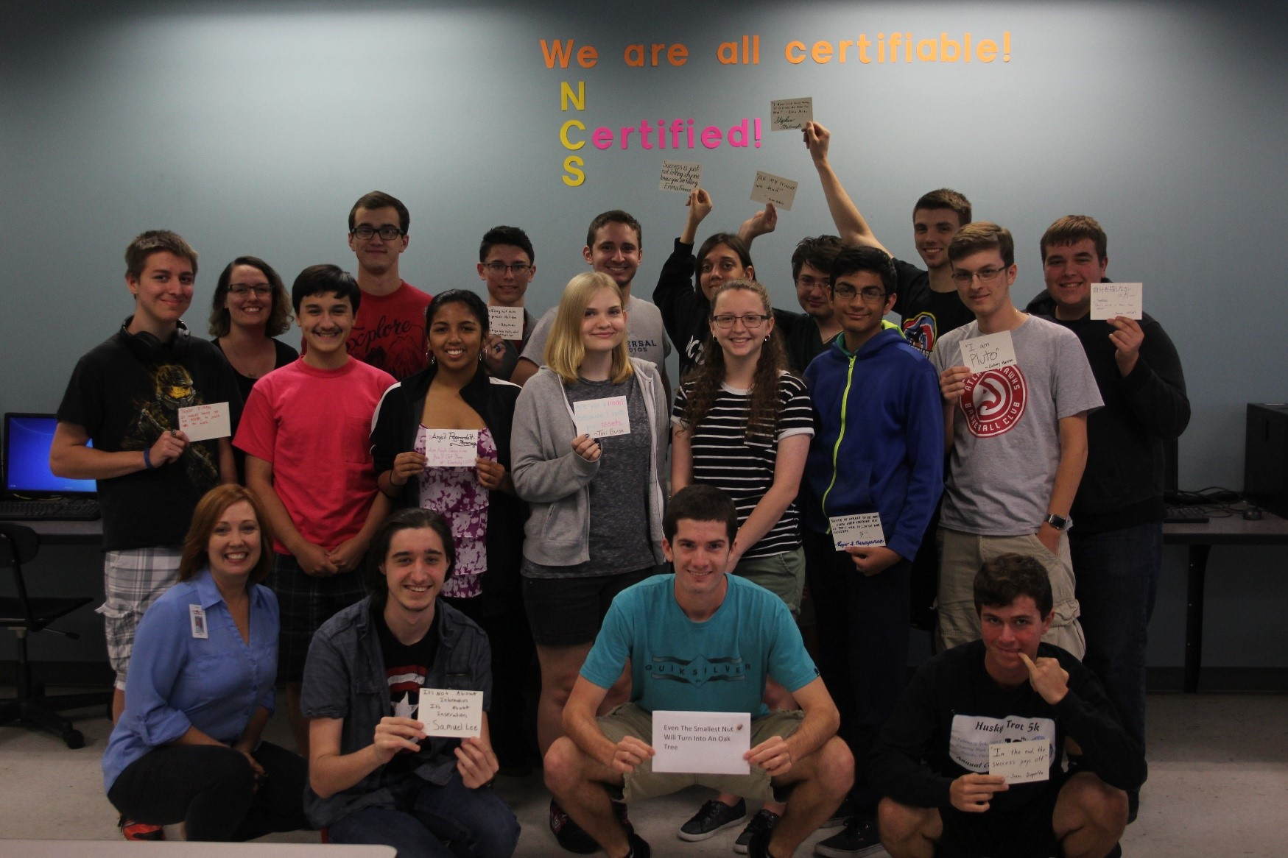
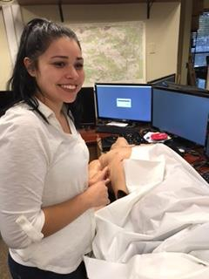
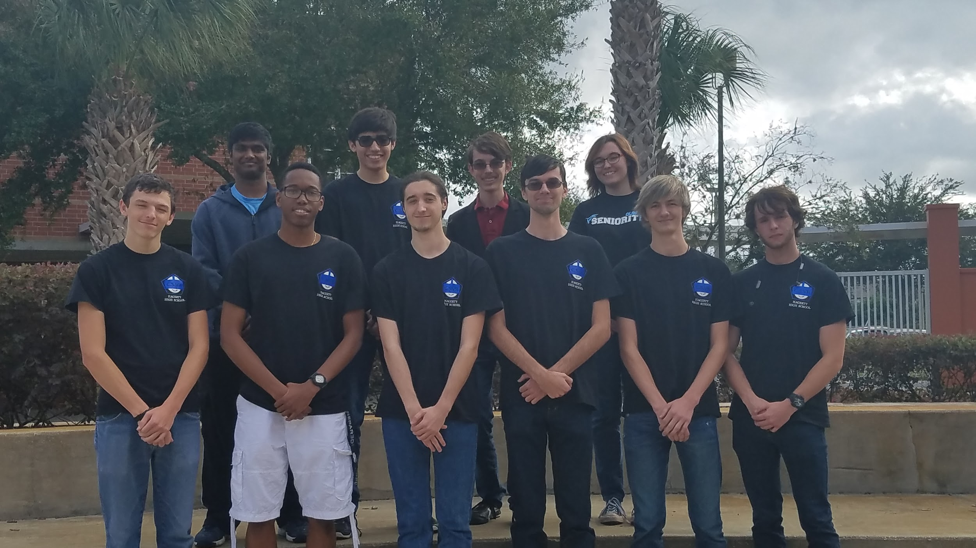
Graduating Class of 2017!
The first graduating class from HHS Mod & Sim !
Congratulations Class of 2018!
2018 Graduates = 32 /41 = 78% of Seniors with NCS Certification entering college and workforce
2017 Graduates (1st 4 yr class) = 27/39 = 69%
Currently 68 Graduates from HHS with NCS Certifications!

Slide 6
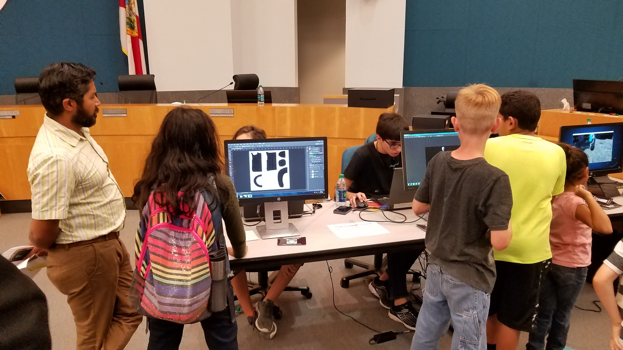
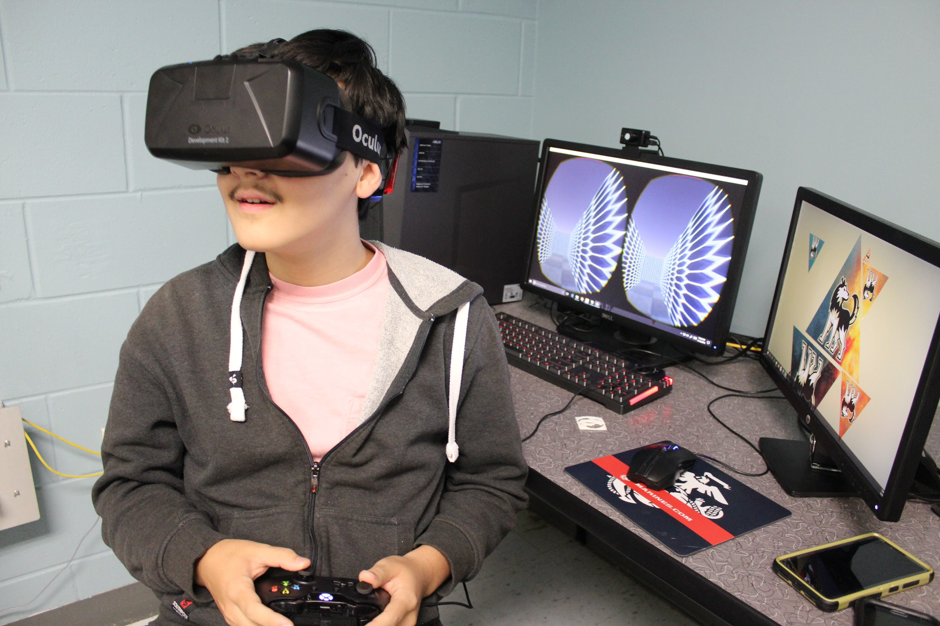
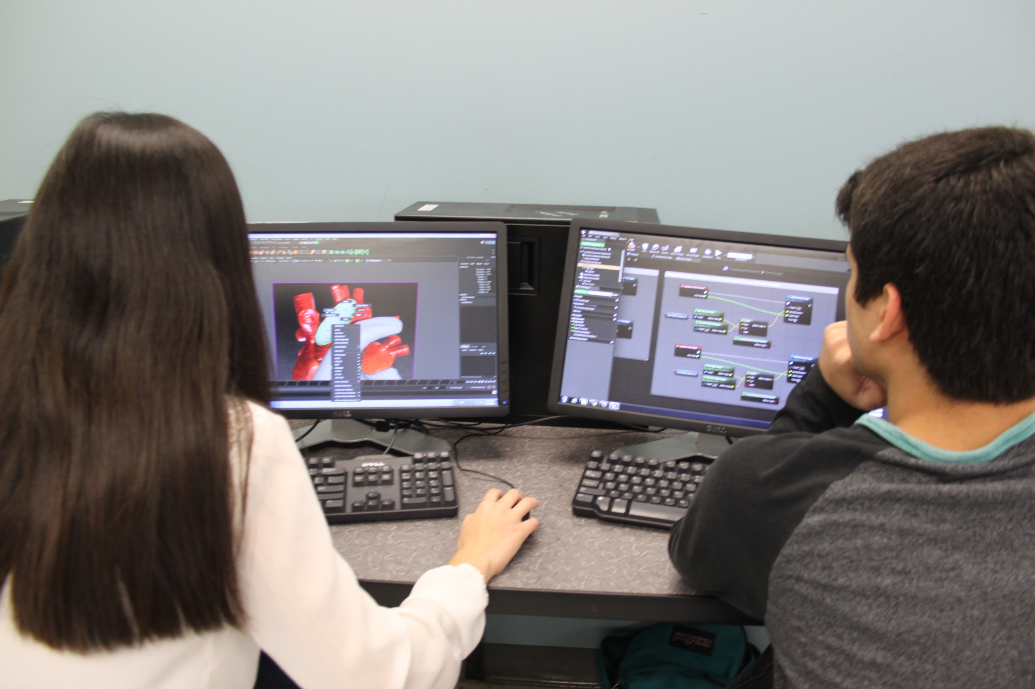
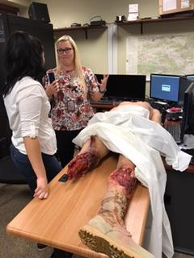
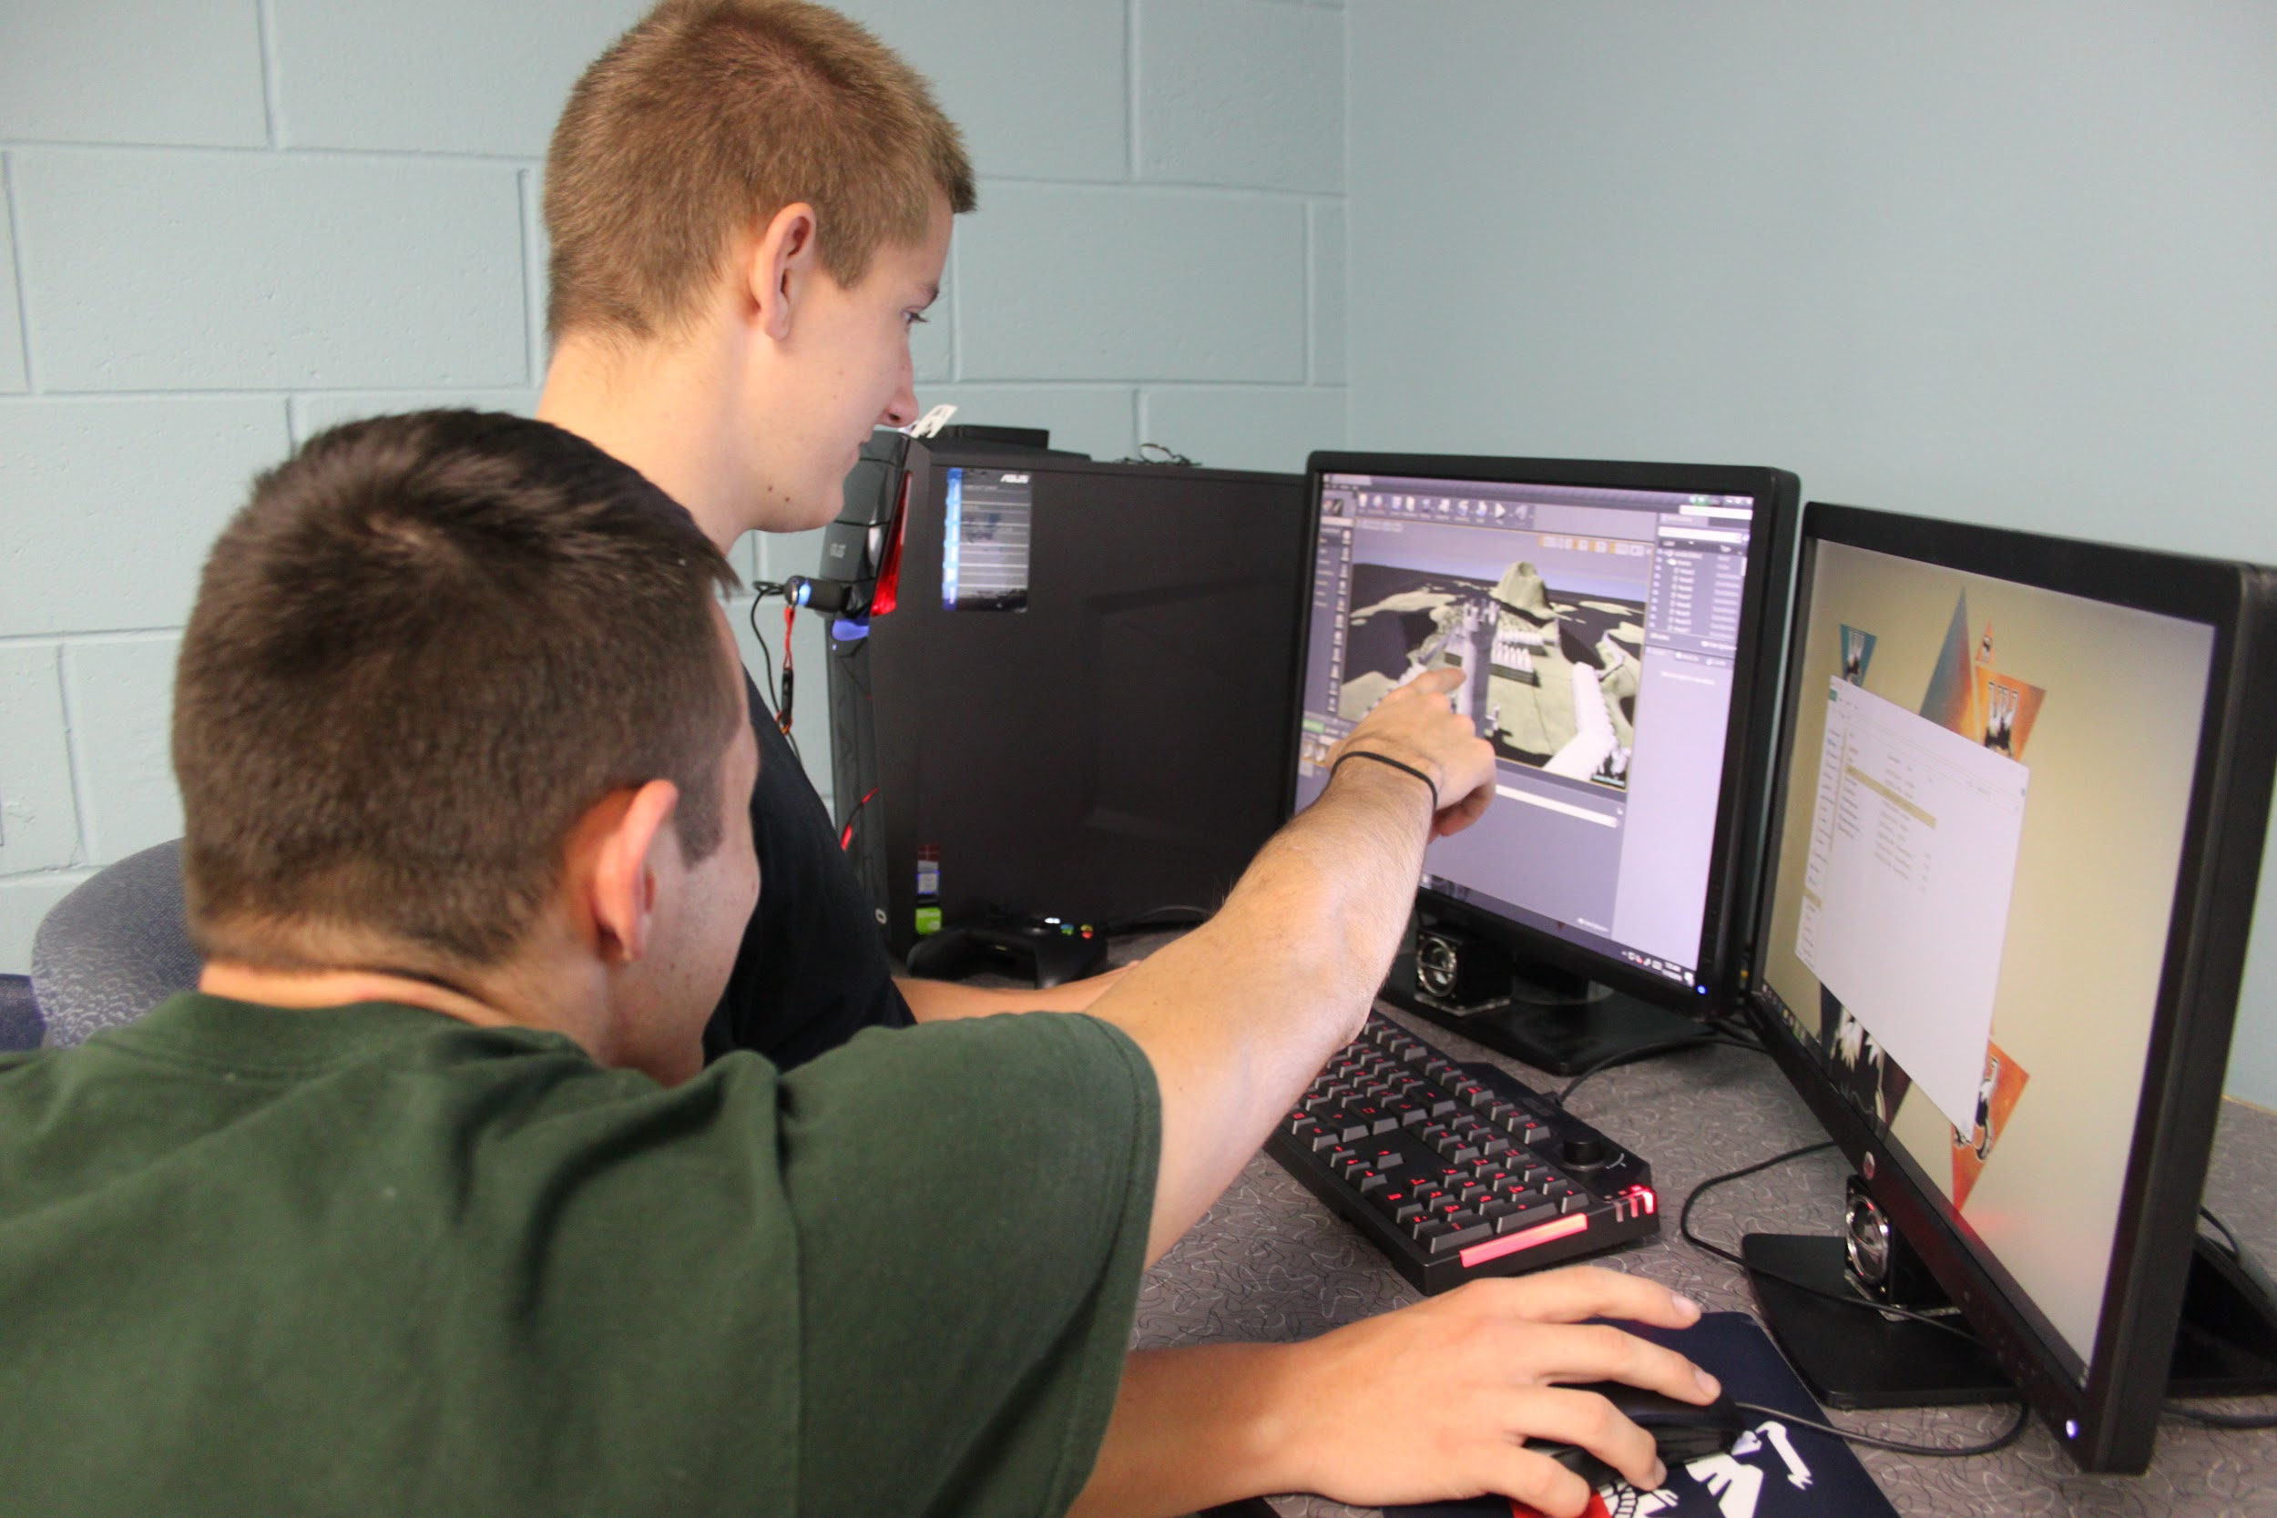
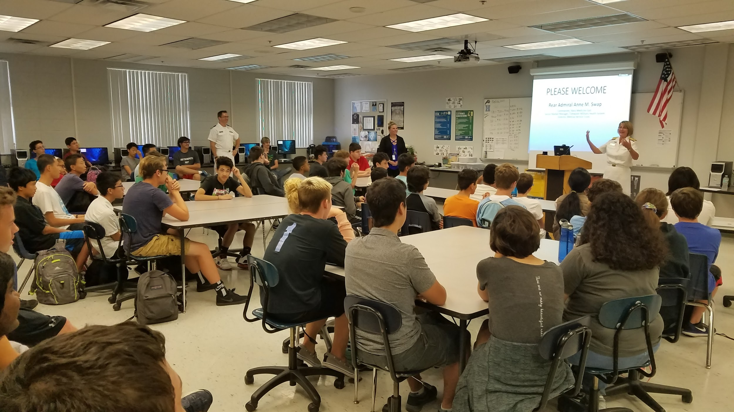
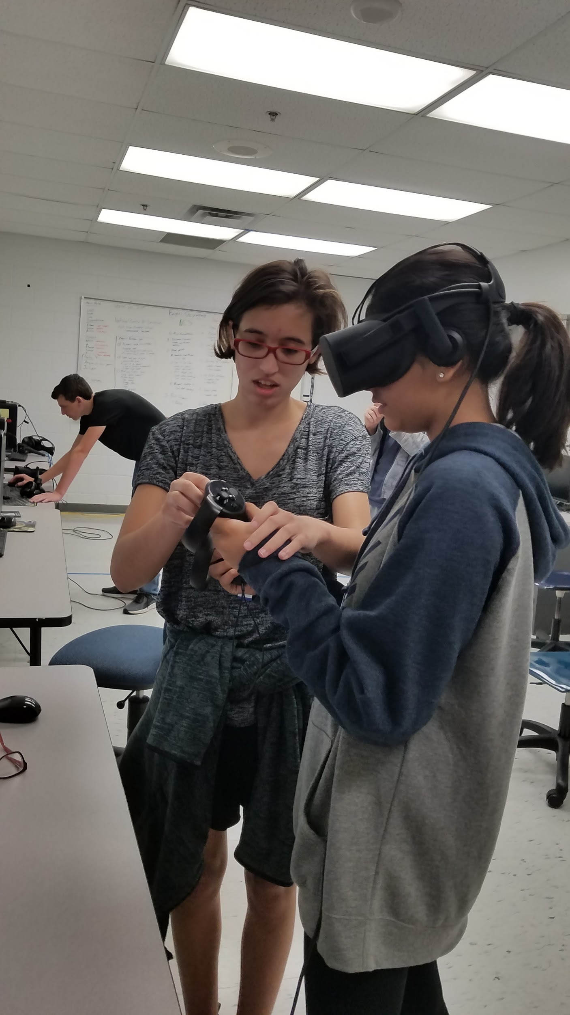
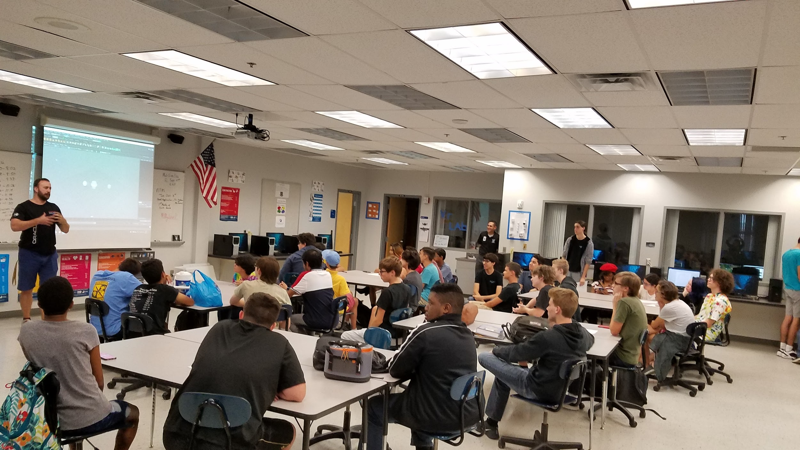
A Look into the M & S Labs at HHS
Not Possible without Industry Support and Community OutReach!

Slide 7
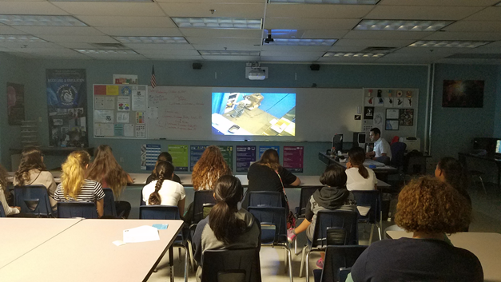
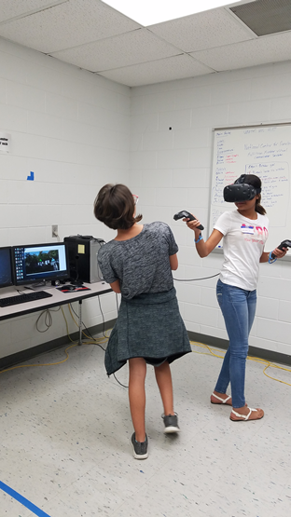
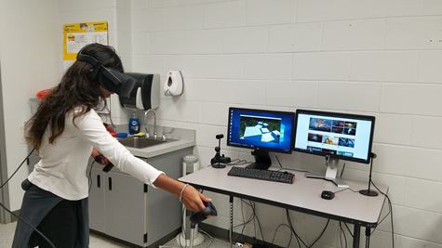
Experts in the Lab
Thank you to STEMConnect, Hank Okraski, Eileen Smith, Anthony Davis, Bob Solitaire and more!

Slide 8
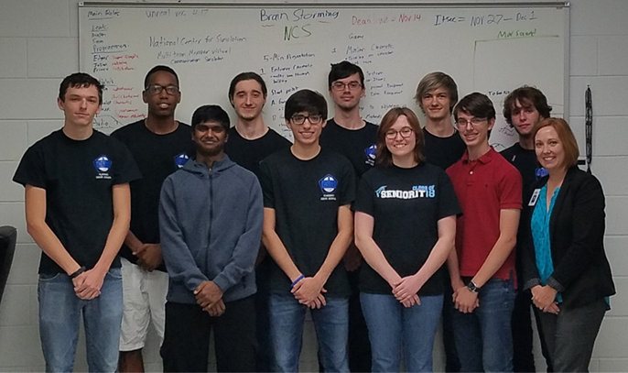
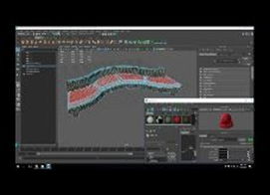
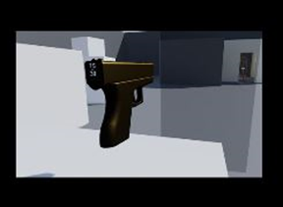
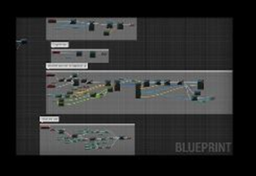
I/ITSEC - 2017
A special Thank You to Disti and NCS for an Exceptional Teaching and Learning Experience!
The purpose of CSVR is to learn about building training systems in virtual reality. The team of mostly high school seniors chose to focus on S.W.A.T. based team communication in different scenarios in order to gain experience working collaboratively to build real world training scenarios in Unreal Real Engine 4. The students are modeling and texturing assets in Maya 2016 and Fusion 360 (both Autodesk products). The level building and programing is being completed in Unreal Engine 4 through C++ blueprinting.

Slide 9
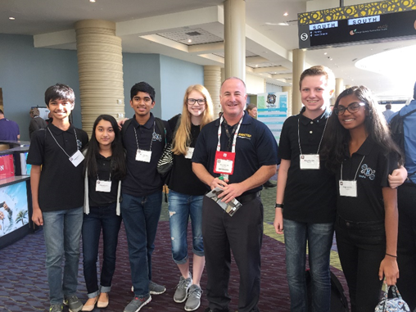
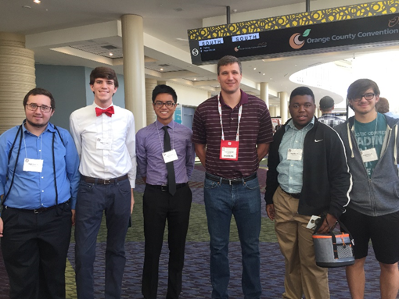
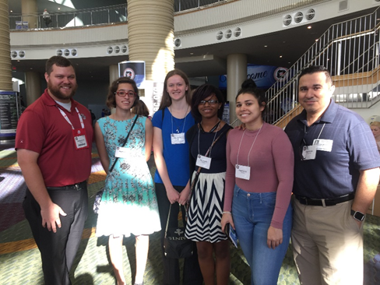
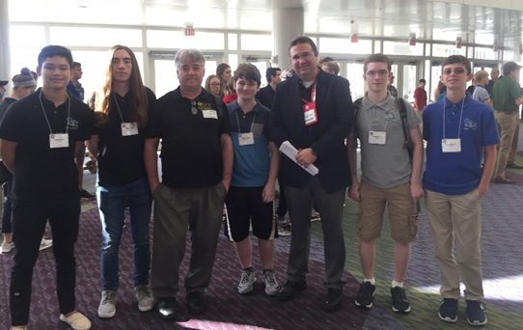
Hagerty High School Students at I/ITSEC 2017
Thursday Student Tour Day
Thank you to our tour guides
and chaperones!

Slide 10
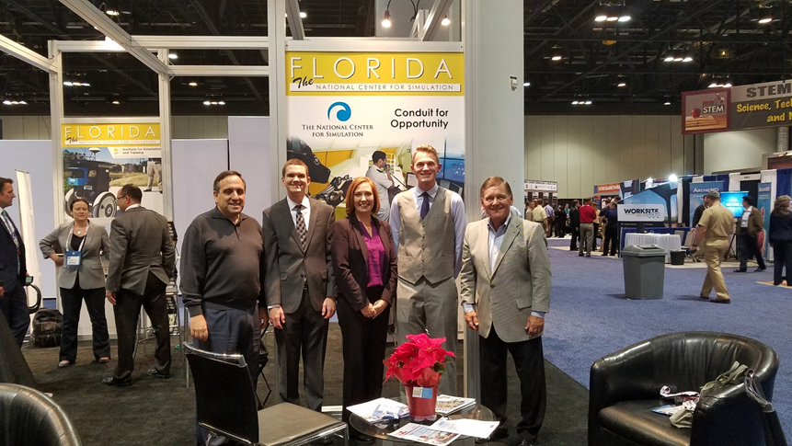
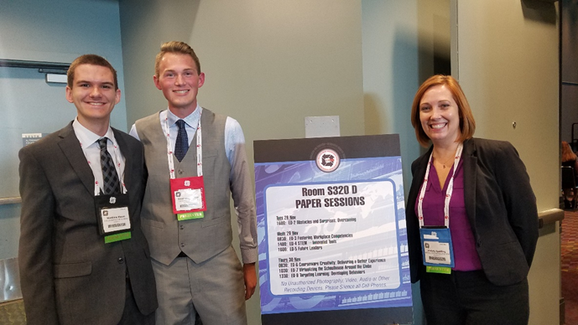
Thank you Ed Deagan - The Bird Dog and the I/ITSEC paper committee!

Slide 11
Thank you for Scholarship Opportunities!
NCS for $1000.00 !
Cole Engineering for Judging Senior Projects and Awarding Scholarship Money!

Slide 12
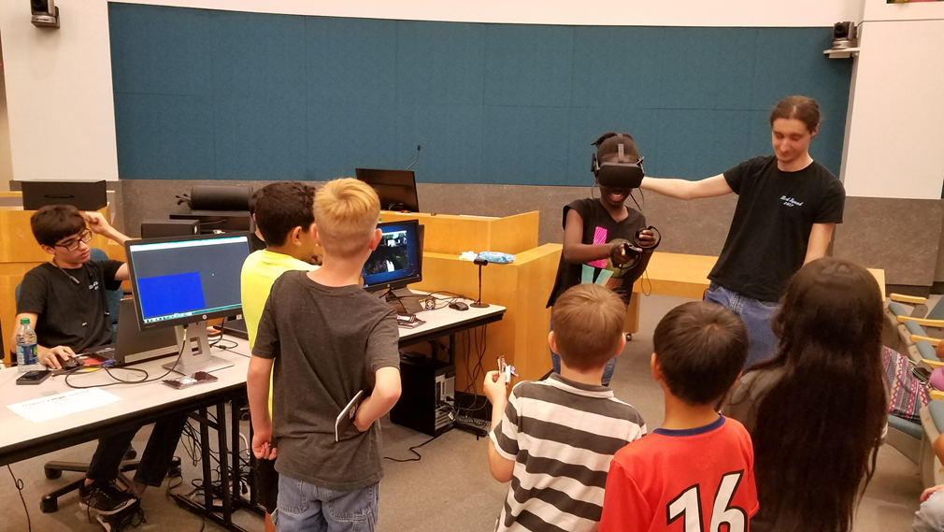
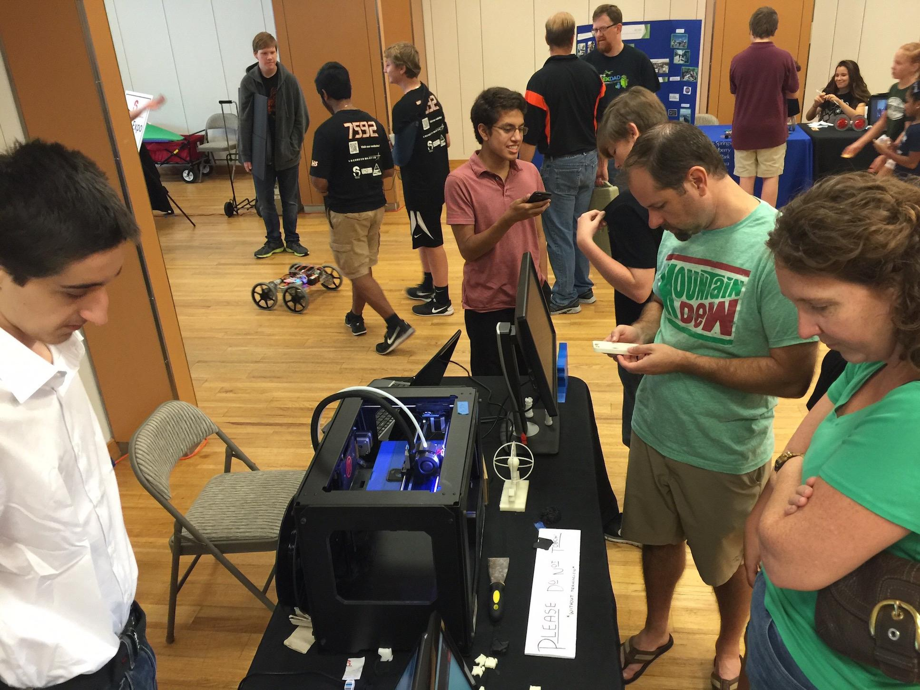
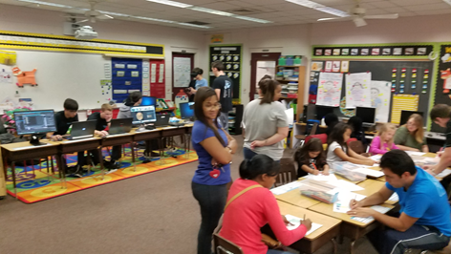
Engaging and Inspiring the Next Generation!
Questions ?

