Slide 1
Tax Incentives for Manufacturers
Simulation Association
December 6, 2011
Steve Roark, CPA
Marni Spence, CPA

Slide 2
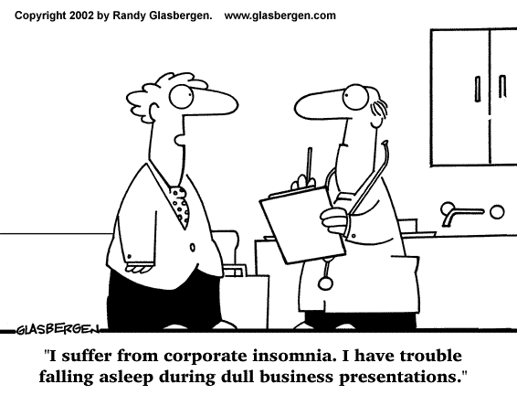
Overview
The Tax Formula
The Research Tax Credit
Cost Segregation & Depreciation
IC-DISC

Slide 3
The Basic Tax Formula
Gross Receipts (Income)
$
2,000,000
Less
Key to Savings
Deductions
(1,500,000)
(reduce taxable income)
(e.g., Depreciation, COGS, Payroll, etc.)
Total Taxable Income
500,000
Income Tax Rate
35%
Tax Due
175,000
Key to Savings
Tax Credits
150,000
($ for $ savings)
Tax Check to IRS
$
25,000

Slide 4
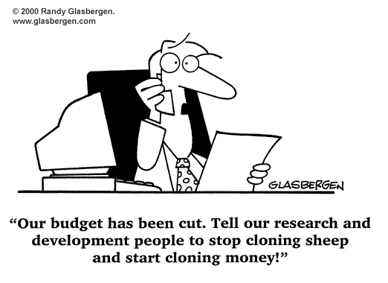
The Research Tax Credit

Slide 5
The Research Tax Credit
Background
  Qualified Business Components
  R&D versus R&E
  General Process
Contracting Considerations
  Rights, Risk, Funding and Contracts
R&E Timeline
Documentation
Credit Calculation

Slide 6
Overview of the Research Credit
Created in 1981
  Temporary part of the tax code – available through 12/31/2011
  Recent guidance has given much better definition of what qualifies and what a valid claim must contain
  Benefit highly lucrative if claimed correctly
Business Component
  New or Improved Product or Process
  New to client (not necessarily the world)
  Process Improvement and/or Redesign may qualify
Buzzwords: Patent, Patent Pending, New, Improved, Engineer, Coder, Design, Test, Prototype, Alpha/Beta, Upgrade

Slide 7
The Picture
    Experimental or laboratory sense = discover info that eliminates “product” development/improvement uncertainty
    Hands on, direct support & direct supervision allowed
    Patent = safe harbor
    New to client (not to world)
    Pilot Model, Process, Formula, Invention, or Technique
IRC §174
Direct Costs
In-Direct Costs
Overhead / G&A
Reimbursable Costs
No Exclusions
IRC §41 = R&E
Wages
Supplies
Contract Research

Slide 8
Contracting Decision Tree
Contract Awarded/
Grant Received
Part/Component
Fixed Price
Cost Plus or
Time & Materials
CLINs
Payment Contingent on Successful R&E?
Separately
Considered
No, Disallowed
(Yes)
Do you have Rights to Use R&E results?
No, Disallowed
Allowable

Slide 9
Timeline Perspective
Disallowed
Activities
Allowable Activities
Disallowed
Activities
Testing & Analysis of Test Results
Commercial Production Approval
Market Research &/or Reverse Engineering
Process of Experimentation to Eliminate Uncertainty
Final Analysis of Information to Make a Production Decision
New Problem Identified during Production
May Potentially Lead
Back to R&E

Slide 10
Industry Specific R&D Timeline
Disallowed
Activities
Allowable Activities
Disallowed
Activities
Pre-Contract Award Work
Market Research
Vendor Research
State of Technology/Training
Reverse Engineering
 | Design
 | Prototypes/Mock-ups and Models
 | Fixtures
 | Testing |  | Program Mgt
 | - CMM |  | Safety
 | - Functional / Flight Test | FAA Certification | Training
 | - Destructive Test | Part 21 - Dem/Val | Technical Writing
 | - HALT |  | Overseas R&E
 |  | Production
 |  | PreProduction Planning
 | Creation of new production Machinery/Processes | Tooling up for Production Debugging
 | Qualification Testing | Trouble Shooting
ECP
May Potentially Lead
Back to R&E

Slide 11
Credit Claim – a 3 Step Process
Identify qualifying research activities
Document qualified activities
Quantify expenses related to qualified activities
Documentation creates NEXUS or a tie between activities and expenses

Slide 12
Credit Calculation
20% Regular
14% Alternative
Example of Base Period Hurdle
Credits Offset Tax Dollar-for-Dollar & Offset 2010 AMT

Slide 13
LarsonAllen Approach
Phase I - Initial Assessment
  Determine framework to establish Nexus between qualifying activities and expenses
  Estimate potential credits
  Determine utilization of benefit
  Go/no-go recommendation
Phase II - Substantiation
  Construct actual Nexus between qualifying activities and expenses
  Document activities & Finalize Credit Calculation
  File on tax return – potentially 4 returns
GOAL: Minimize Impact on Client – Maximize Benefit – Create Audit Support

Slide 14
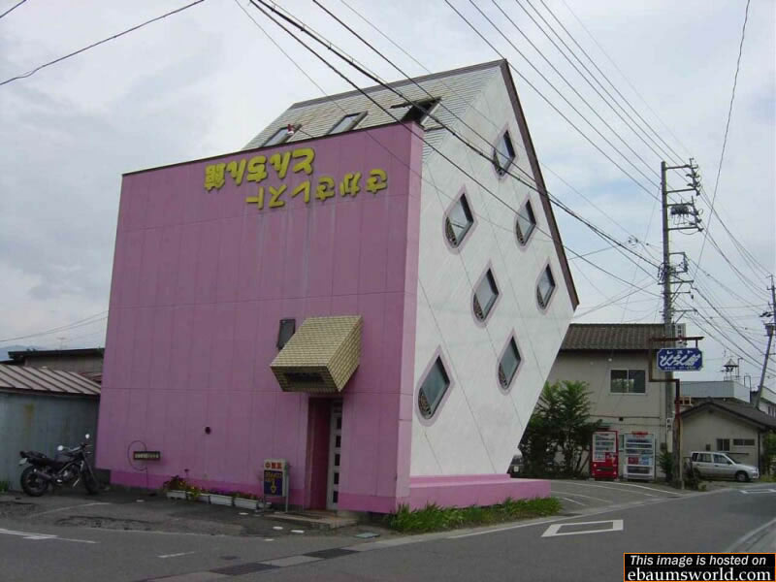
Cost Segregation

Slide 15
Cost Segregation
Why perform a cost segregation?
  Maximize tax deferral
    Tax deferrals are accelerated into early years
    $1 worth more today than 40 years from now
  Increase cash flow
    Tax savings in early years generates additional cash flow to reinvest

Slide 16
Cost Segregation
Classify separate component lives
  39/27.5 year property re-classed to 5, 7 or 15 year lives (see Rev. Proc. 87-56)
Activities that benefit include:
  New Construction
  Purchase of an existing building
  Additions
  Renovations
  Leasehold or tenant improvements
Benefit – More depreciation in early years

Slide 17
Cost Segregation
Example: ($3.9M building, renovation, etc.)

Slide 18
Depreciation Alternatives
Cost Segregation
  Applied to New Construction, Renovations, Additions, Leasehold or Tenant Improvements
  Breaks Out Items into Shorter Lives (5, 7, 15 year, etc.)
  Can Perform After the Fact
  Single Lump Sum Retro Catch Up Okay
Bonus Depreciation – new only
  100% of purchase price, class life of 20 years or less, thru 12/31/11
  Decreases to 50% in 2012
  Unlimited Amount
Section 179 – new and used
  $500K max - Purchase Price/Lease of equipment/software
  Phase out ($ for $ reduction over $2M)
  $125K max tax years beginning in 2012 – Phase out lowers to $500K

Slide 19

IC-DISC
(Interest Charge - Domestic International Sales Corporation)

Slide 20
IC-DISC
Company sells goods
Pays a commission to the IC-DISC and deducts the amount of the commission
DISC can loan commission money back to exporter, or
DISC pays a dividend to shareholders
  Currently 15% tax rate
B
A

Slide 21
IC-DISC Example

Slide 22
IC-DISC – Key Points
Export sales filed as commission income via 1120 IC-DISC
Reclassifies export sales from ordinary income to qualified dividend
  Reduces tax rate from 35% to 15%
  $10M Exports generate minimum of $80K tax savings, sometimes much more
Paper corporation only
  Customers need not know of existence

Slide 23
Conclusion
Tax credits, deductions, bonus depreciation and other tax planning mechanisms create significant incentives for businesses
Recent Events:
  Add urgency to acting now
  Are Designed for Businesses to Create Cash Flow
  Sustain Jobs and Incentivize Investment

Slide 24

Discussion

